Slide 1
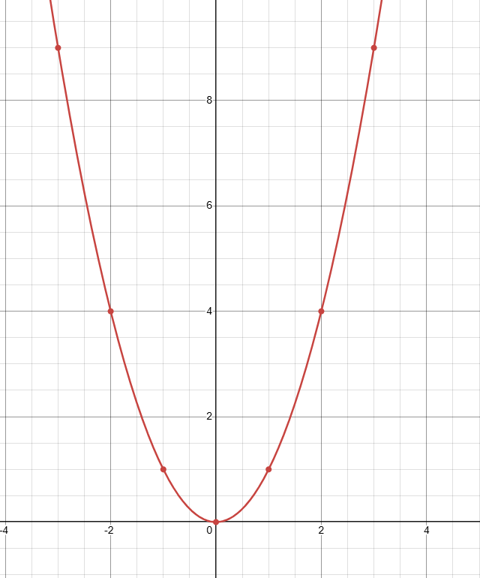
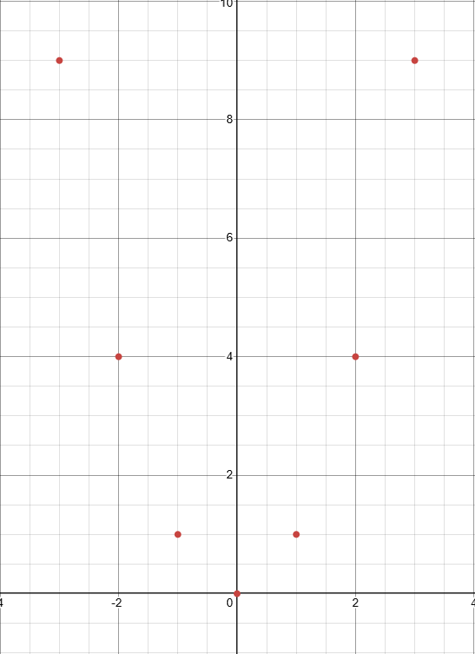
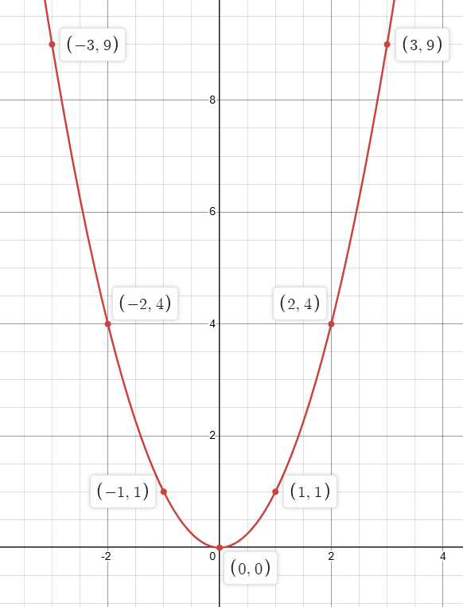




















DRAWING PARABOLAS USING A TABLE OF VALUES
For each question complete a table of values, plot the points on the graph, and draw the parabola.
$$y=x^{2}$$
$$\left(x,y\right)$$
-3
-2
-1
0
1
2
3
$$x$$
$$y=x^{2}$$
$${y=\left(−3\right)}^{2}=1$$
$$\left(−3,9\right)$$
$${y=\left(−2\right)}^{2}=4$$
$$\left(−2,4\right)$$
$${y=\left(−1\right)}^{2}=1$$
$$\left(−1,1\right)$$
$${y=\left(0\right)}^{2}=0$$
$$\left(0,0\right)$$
$${y=\left(1\right)}^{2}=1$$
$$\left(1,1\right)$$
$$y= {\left(2\right)}^{2}=4$$
$$\left(2,4\right)$$
$$y= {\left(3\right)}^{2}=9$$
$$\left(3,9\right)$$
Location of x-intercept:
$$\left(0, 0\right)$$
Location of y-intercept:
$$\left(0, 0\right)$$

Slide 2
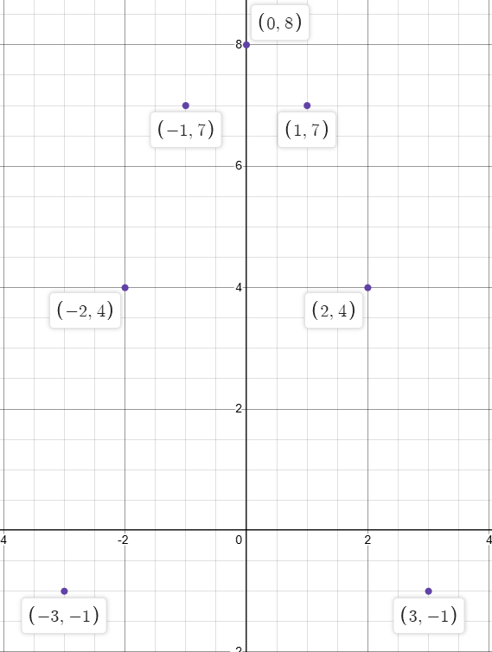
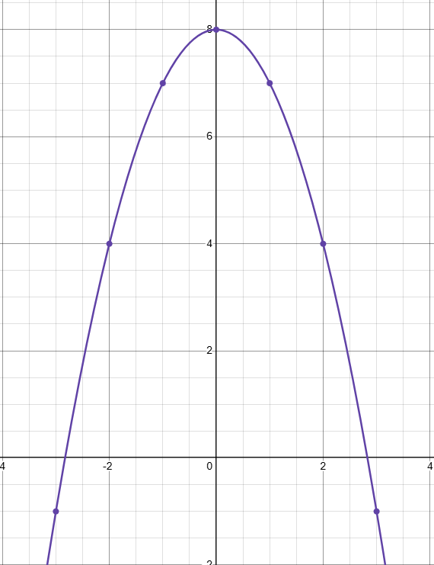





















DRAWING PARABOLAS USING A TABLE OF VALUES
For each question complete a table of values, plot the points on the graph, and draw the parabola.
$$y=−x^{2}+8$$
$$\left(x,y\right)$$
-3
-2
-1
0
1
2
3
$$x$$
$$y={−x}^{2}+8$$
$$y=−{\left(−3\right)}^{2}+8=−1$$
$$\left(−3,−1\right)$$
$$y=−{\left(−2\right)}^{2}+8=−1$$
$$\left(−2,−4\right)$$
$$y=−{\left(−1\right)}^{2}+8=−1$$
$$\left(−1,−7\right)$$
$$y=−{\left(0\right)}^{2}+8=−1$$
$$\left(0,−8\right)$$
$$y=−{\left(1\right)}^{2}+8=−1$$
$$\left(1 , 7\right)$$
$$y=−{\left(2\right)}^{2}+8=−1$$
$$\left(2, 4\right)$$
$$y=−{\left(3\right)}^{2}+8=−1$$
$$\left(3,−1\right)$$
Location of x-intercept:
$$\left(−2.8, 0\right)$$
$$\left(2.8, 0\right)$$
Location of y-intercept:
$$\left(0, 8\right)$$

Slide 3
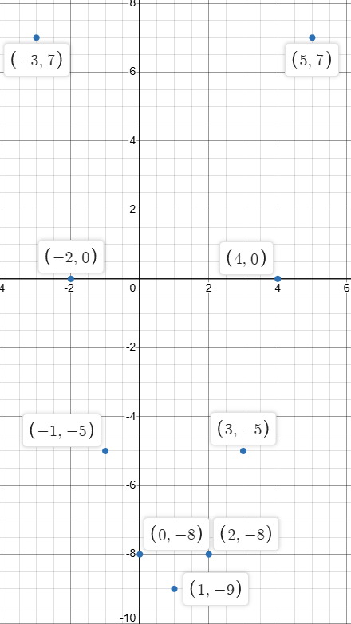
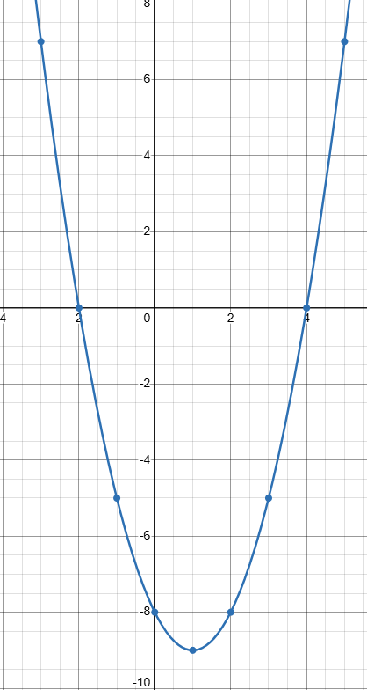





















DRAWING PARABOLAS USING A TABLE OF VALUES
For each question complete a table of values, plot the points on the graph, and draw the parabola.
$$y=x^{2}−2x −8$$
$$x$$
$$y=x^{2}−2x−8$$
$$\left(x,y\right)$$
-3
-2
-1
0
1
2
3
$$y={\left(−3\right)}^{2}−2\left(−3\right)−8=7$$
$$\left(−3, 7\right)$$
$$y={\left(−2\right)}^{2}−2\left(−2\right)−8=0$$
$$\left(−2, 0\right)$$
$$y={\left(−1\right)}^{2}−2\left(−1\right)−8−5$$
$$\left(−1,−5\right)$$
$$y={\left(0\right)}^{2}−2\left(0\right)−8=−8$$
$$\left(0,−8\right)$$
$$y={\left(1\right)}^{2}−2\left(1\right)−8=−9$$
$$\left(1 , −9\right)$$
$$y={\left(2\right)}^{2}−2\left(2\right)−8=−8$$
$$\left(2, −8\right)$$
$$y={\left(3\right)}^{2}−2\left(3\right)−8=−5$$
$$\left(3,−5\right)$$
Location of x-intercept:
$$\left(−2, 0\right)$$
$$\left(4, 0\right)$$
Location of y-intercept:
$$\left(0, −8\right)$$

Slide 4
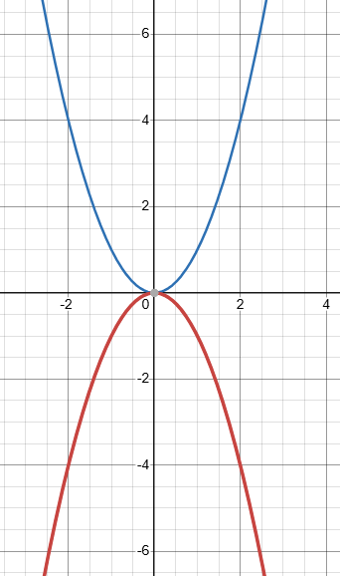


Some Initial Observations About Quadratic Equations (y = Ax² +Bx +C)
What does the negative sign in front of the x² term do to the graph? (i.e., x² vs. -x²)
$$y=x^{2}$$
Makes the graph open downward
$$y={−x}^{2}$$

Slide 5
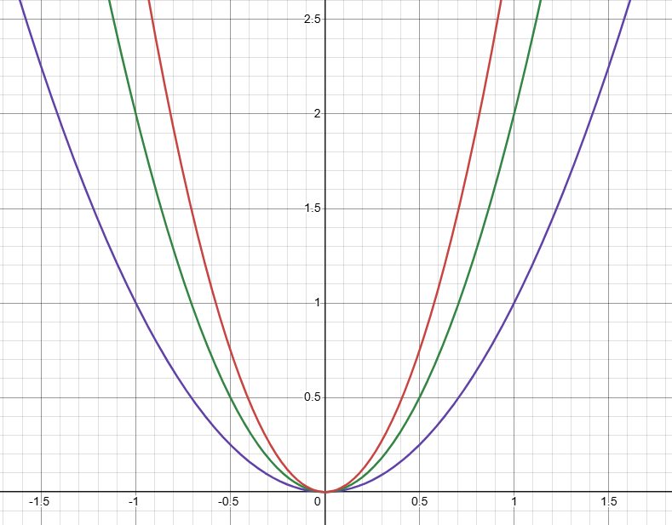




What happens when the coefficient in front of the
$$x^{2}$$
term increases?
The slope of the graph
becomes steeper

Slide 6
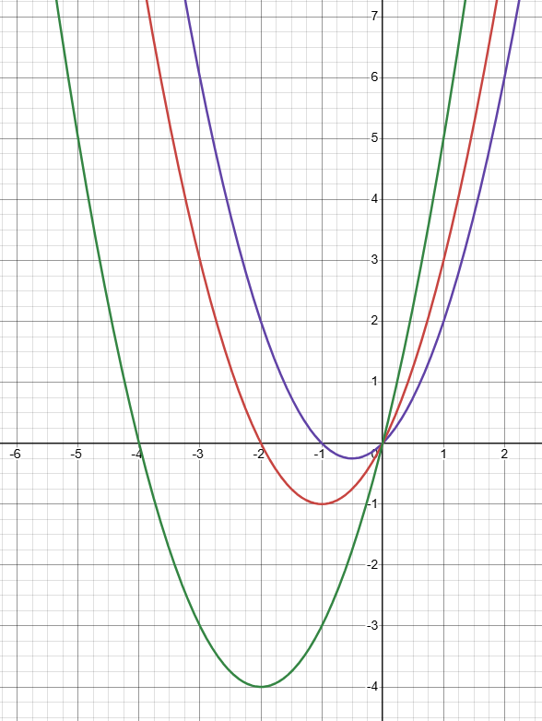



What happens when there is a coefficient in front of the x term?
Answer:
It moves the graph left & right

Slide 7
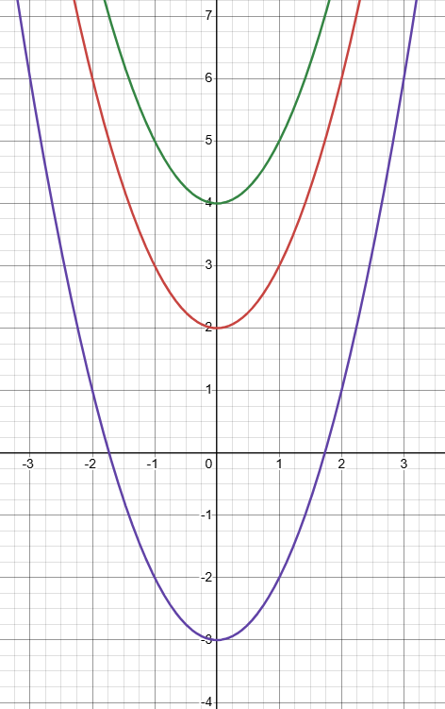




What happens when the equation has a constant term at the end? that is, the value of
$$c≠0$$
Answer:
It moves the graph up & down

Slide 8
Quadratic Sites
https://www.intmath.com/quadratic-equations/interactive-quadratic-function-graph.php
https://phet.colorado.edu/sims/html/graphing-quadratics/latest/graphing-quadratics_all.html
https://www.mathsisfun.com/quadratic-equation-solver.html

