Slide 1






Trinomials in the form
$$x^{2}+bx+c$$
can be easily factored once you find
a pair of integers that both
multiply together to give ‘c’ and
add together to give ‘b’
Example 1:
Factor
$$x^{2}+5x+6$$
Find 2 #’s that add together to make 5 and multiply together to make 6
6
Step 1: Find all the factors of 6 (pairs of numbers that multiply together to get +6)
Step 2: Add the factor pairs together to see which one equals +5
Step 3: Write the factors, including the signs, inside the brackets
Step 4: Check your answer by expanding the factors using FOIL
1 | 6
-1 | -6
2 | 3
-2 | -3
$$=5$$
2 & 3 multiply to 6
add to 5
$$\left(x+2\right)\left(x+3\right)$$
$$=x^{2}+3x+2x+6$$
$$=x^{2}+5x+6$$

Slide 2





Example 2:
Factor
$$x^{2}−9x+20$$
Find 2 #’s that add together to make -9 and multiply together to make 20
mult: 20
add: -9
20
1 | 20
-1 | -20
2 | 10
-2 | -10
4 | 5
-4 | -5
$$\left(x−4\right)\left(x−5\right)$$
$$=x^{2}−5x−4x+20$$
$$=−9$$
$$=x^{2}−9x+20$$
From now on, when you factor a trinomial, choose two numbers that
­­­________ to equal the middle number and ___________ to equal the last number.
add
multiply

Slide 3



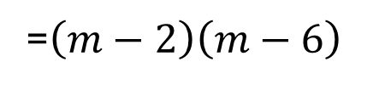

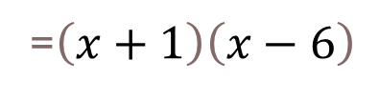
Example 3:
Factor
$$x^{2}−5x−6$$
Factor
$$m^{2}−8m+12$$
mult: -6
add: -5
mult: 12
add: -8
20
-6
1 | 12
-1 | -12
2 | 6
-2 | -6
3 | 4
-3 | -4
1 | -6
-1 | 6
2 | -3
-2 | 3
$$=−5$$
$$=−8$$
=$\left(x+1\right)\left(x−6\right)$
=$\left(m−2\right)\left(m−6\right)$

Slide 4






Factor
$$x^{2}−x−12$$
Factor
$$x^{2}+10x+16$$
mult: -12
add: -1
mult: 16
add: 10
-12
16
1 | 12
-1 | 12
2 | -6
-2 | 6
3 | -4
-3 | 4
1 | 16
-1 | -16
2 | 8
-2 | -8
4 | 4
-4 | -4
$$=10$$
$$=−1$$
$$=\left(x+2\right)\left(x−4\right)$$
$$=\left(x+2\right)\left(x+8\right)$$

Slide 5




Example 4:
Common Factor First
$$2x^{2}+2x−12$$
$$2\left(x^{2}+x−6\right)$$
mult: -6
add: 1
-6
$$=2\left(x−2\right)\left(x+3\right)$$
1 | -6
-1 | 6
2 | -3
-2 | 3
$$=1$$

Slide 6




Common Factor First
$$3x^{2}+18x+27$$
$$3\left(x^{2}+6x+9\right)$$
mult: 27
add: 18
9
$$=3\left(x+3\right)\left(x+3\right)$$
1 | 9
-1 | -9
3 | 3
-3 | -3
$$=6$$

Slide 7
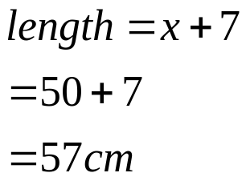
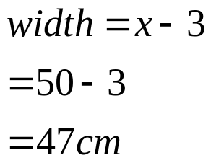




Example 5:
A rectangle has an area repented by the trinomial x² + 4x – 21.
Factor the trinomial to find expressions for the dimensions of the rectangle.
mult: -21
add: 4
-21
1 | -21
-1 | 21
3 | -7
-3 | 7
$$\left(x−3\right)\left(x+7\right)$$
$$=4$$
$$\left(x+7\right)$$
b) Calculate the actual dimensions if x = 50 cm
$$\left(x−3\right)$$

