Slide 1

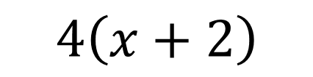


ALGEBRAIC EXPRESSIONS (Review)
An algebraic expression is a mathematical statement made up of _____________ and _________________.
terms
operations
Distributive Property (Rainbow)
**Only necessary when…
There is a number ‘attached’ to a bracket with multiplication
$$4\left(x+2\right)$$
$$4x$$
$$+$$
$$8$$
Remember –(x + 1) is the same as –1(x + 1)

Slide 2
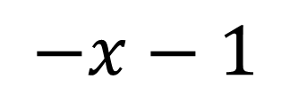
Remember –(x + 1) is the same as –1(x + 1)
$$−x−1$$

Slide 3
























$$2\left(x+1\right)$$
$$\left(2x−7\right)6$$
$$2x$$
$$+2$$
$$12x$$
$$−42$$
$$2x−\left(x−1\right)$$
$$3y+6\left(2y+1\right)$$
$$2x$$
$$−1x$$
$$+1$$
$$3y$$
$$+12y$$
$$+6$$
$$x+1$$
$$15y+6$$
$$4x+\left(3x−1\right)$$
$$−5\left(4x−10\right)$$
$$4x$$
$$+3x$$
$$−1$$
$$−20x$$
$$+50$$
$$7x−1$$

Slide 4








Collecting Like Terms
“Like Terms” have exactly the same variable raised to the same exponent. Simplify equations by collecting like terms. A simplified expression will have NO like terms.
Simplify
a)
$$2b+7a+8b−a+3b^{2}$$
$$3b^{2}$$
$$+10b$$
$$+6a$$
$$3−x^{2}+2x+3x^{2}−4+3x$$
b)
$$2x^{2}$$
$$+5x$$
$$−1$$

Slide 5











$$y+y+y$$
$$3y$$
a³ = | 2³ =
c) (2y)³ = | d) 3x + (-3x)² – (x + 1)
$$y×y×y$$
$$y^{3}$$
$$a×a×a$$
$$2×2×2$$
=$\left(4y^{2}\right)\left(2y\right)$
$$=3x+{\left(−3x\right)}^{2}{\left(x\right)}^{2}−1x−1$$
$$=8y^{3}$$
$$=3x−1x+9x^{2}−1$$
$$=9x^{2}+2x−1$$

Slide 6













Evaluating Algebraic Expressions
Substitute the value for the variable and solve.
Solve
$$2x+3$$
for x = 3
$$2x+3$$
for x = -4
$$=2\left(3\right)+3$$
$$=2\left(−4\right)+3$$
$$=6$$
$$=−5$$
$$4x^{2}$$
for x = 2
$${\left(4x\right)}^{2}$$
for x = 2
$$=4{\left(2\right)}^{2}$$
$$={\left[4\left(2\right)\right]}^{2}$$
$$=16$$
$$={\left[8\right]}^{2}$$
$$=64$$

Slide 7
5) Factors of Numbers
A factor is a ________________ or __________________ that divides _____________ into another ________________ or __________________.
number
expression
evenly
number
expression
Factor 20
Factor 16
Factor -27
Factor 20
1 | 20
-1 | -20
2 | 10
-2 | -10
4 | 5
-4 | -5
1 | 16
-1 | -16
2 | 8
-2 | -8
4 | 4
-4 | -4
1 | -27
-1 | 27
3 | -9
-3 | 9
1 | -12
-1 | 12
2 | -6
-2 | 6
3 | -4
-3 | 4

Slide 8
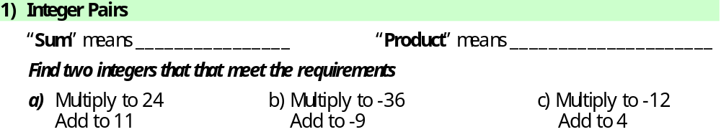
addition
multiplication
1 | 24
-1 | -24
2 | 12
-2 | -12
3 | 8
-3 | -8
4 | 6
-4 | -6
1 | -36
-1 | 36
2 | -18
-2 | 18
3 | -12
-3 | 12
4 | -9
-4 | 9
1 | -12
-1 | 12
2 | -6
-2 | 6
3 | -4
-3 | 4

