Slide 1
SOLVING LINEAR SYSTEMS – ELIMINATION METHOD - part 2
If you have a linear system, you can solve it by adding or subtracting the equations in order to eliminate a variable.
BUT…what happens when the coefficients are NOT THE SAME????
Steps: 1) Choose the equation with only an x or y (coefficient of 1) and multiply
it by a number to create a term that is the same as in the other equation.
2) Add or subtract the two equations so that you eliminate either of
the variables “x” or “y”.
3) Find the solution for one variable.
4) Substitute the solution into either of the original equations and solve
for the other variable.
5) Write a concluding statement "∴ the solution is (x, y)."

Slide 2
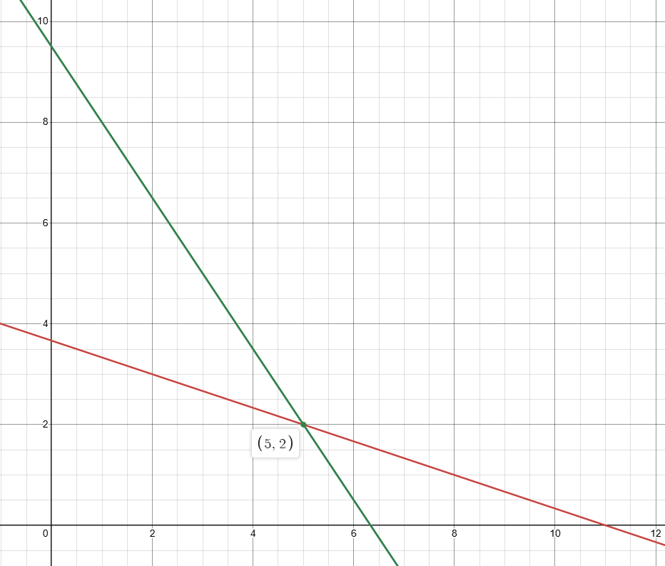











1. Solve: x + 3y = 11
3x + 2y = 19
multiply by 3
$$3\left(x+3y=11\right)$$
$$3x+9y=33$$
$$3x+2y=19$$
Both values are positive
so, use subtraction
to eliminate x
$$0+7y=14$$
$$7y=14$$
$$y=2$$
Solve for x :
$$x+3y=11$$
$$x+3\left(2\right)=11$$
$$x=11−6$$
$$x=5$$
POI is

Slide 3
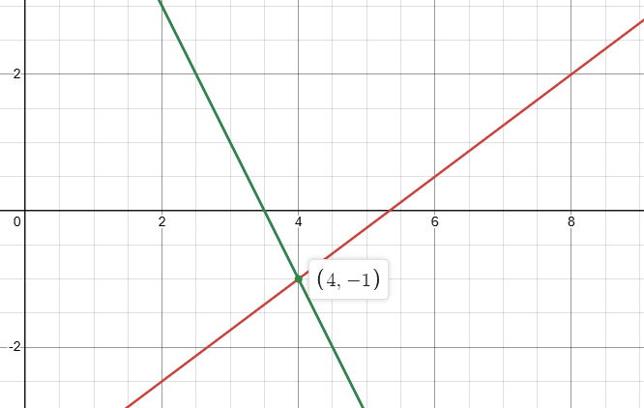










2. Solve: 3x – 4y = 16
2x + y = 7
multiply by 4
$$3x−4y=16$$
$$4\left(2x+y=7\right)$$
$$8x+4y=28$$
$$11x+0=44$$
Signs are different
so, use addition
to eliminate y
$$11x=44$$
$$x=4$$
Solve for y :
2x + y = 7
$$2\left(4\right)+y=7$$
$$y=7−8$$
$$y=−1$$
POI is

Slide 4






Example:
A company hosted a winter holiday reception at a local banquet hall and served two different dinners. There were 200 people who attended the function.
Let x represent the # roast beef dinners and y represent the # of grilled chicken dinners.
This is represented by the equation: x + y = 200
The roast beef dinner cost $21 per plate and the grilled chicken dinner cost $15 per plate. The dinner cost the company a total of $3720.
This is represented by the equation: 21x + 15y = 3720
$$15\left(x+y=200\right)$$
$$15x+15y=3000$$
$$21x+15y=3720$$
$$−6x+0=−720$$
$$6x=720$$
$$x=120$$

Slide 5
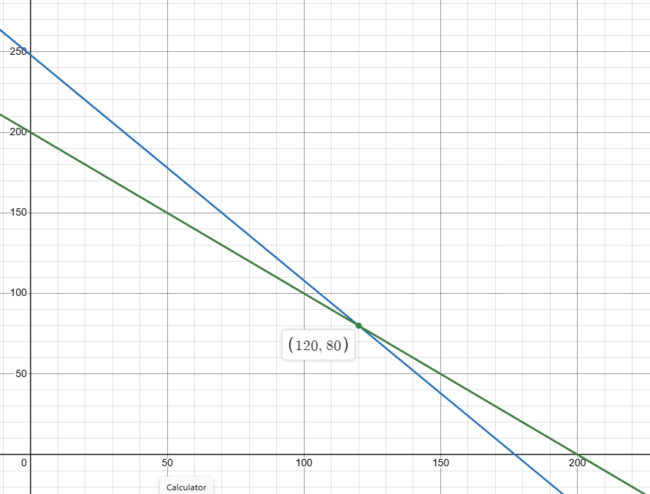






…from previous slide.
x + y = 200
21x + 15y = 3720
$$x=120$$
Solve for y :
x + y = 200
$$120+y=200$$
$$y=200−120$$
$$y=80$$
POI is
At the dinner, 120 roast beef and 80 chicken dinners were served.

