Slide 1
SOLVE LINEAR SYSTEMS USING ELIMINATION METHOD
If you have a linear system, you can solve it by adding or subtracting the equations in order to eliminate a variable.
Steps: 1) Add or subtract the 2 equations so that you eliminate either of
the variables “x” or “y”.
2) Find the solution for one variable.
3) Substitute the solution into either of the original equations and solve
for the other variable.
4) Write a concluding statement: ∴ the solution is (x, y).

Slide 2
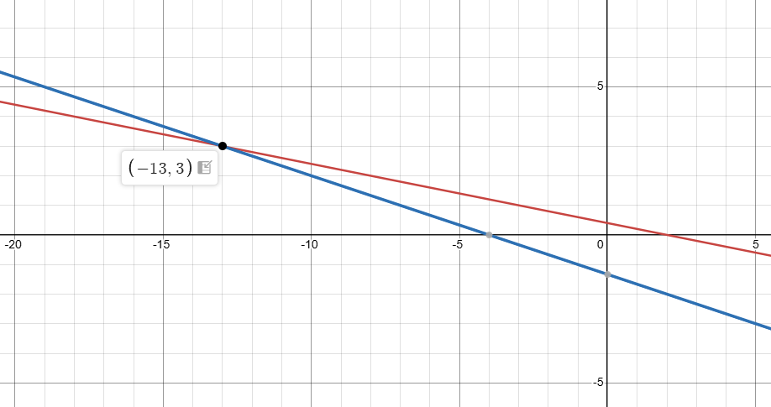




Examples:
1. Solve: x + 5y = 2
x + 3y = -4
Add or subtract the equations to eliminate
one of the variables and then solve:
x | + 5y | = 2
x | + 3y | = -4
minus
0
5y-3y
= 2-(-4)
2y
= 6
y
= 3
Solve for the other variable:
$$x+5y=2$$
$$x+5\left(3\right)=2$$
POI is
$$x=−13$$

Slide 3
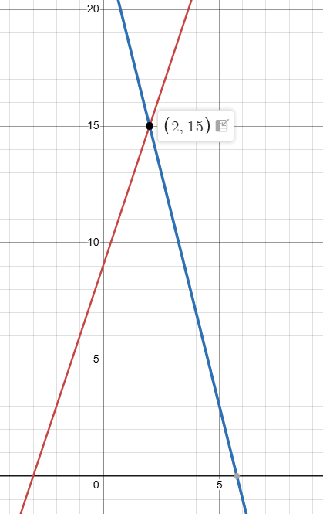





Examples:
2. Solve: 3x - y = -9
4x + y = 23
Add or subtract the equations to eliminate
one of the variables and then solve:
3x | - y | = -9
4x | + y | = 23
3x + 4x
0
= -9 + 23
7x
= 14
x
= 2
Solve for the other variable:
$$3x−y=−9$$
$$3\left(2\right)−y=−9$$
$$−y=−15$$
POI is
$$y=15$$

Slide 4
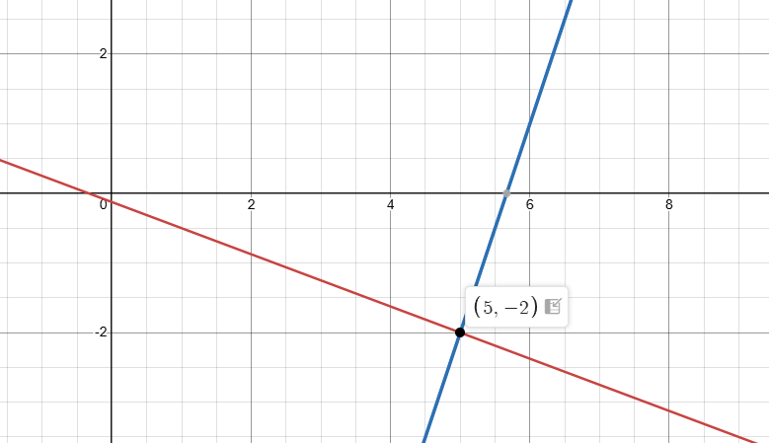







Linear Systems: ELIMINATION – Addition or Subtraction?
To solve the following linear systems of equations by elimination, identify if you would use addition or subtraction method AND which variable you would eliminate first.
Note: you do not have to find the solution to the system.
3x + 8y = -1
-3x + y = -17
Add
$$0+9y=−18$$
$$y=−2$$
Solve for x:
$$3x+8\left(−2\right)=−1$$
$$3x=15$$
$$x=5$$
POI is
To eliminate the variable ______ first,
I would use ___________________
$$x$$
addition

Slide 5
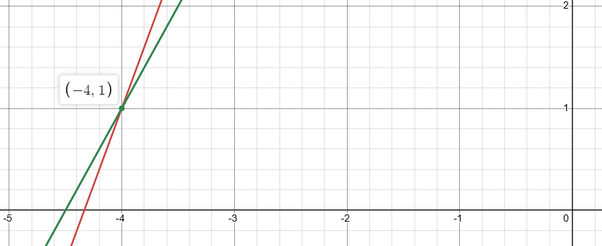








3x - y = -13
2x - y = -9
subt.
To eliminate the variable ______ first, I would use ___________________
$$y$$
$$x−0=−4$$
subtraction
$$x=−4$$
Solve for y :
$$3x−y=−13$$
$$3\left(−4\right)−y=−13$$
$$−y=−13+12$$
$$y=1$$
POI is

Slide 6
Add if signs are DIFFERENT
Subt. if signs are the SAME

Slide 7
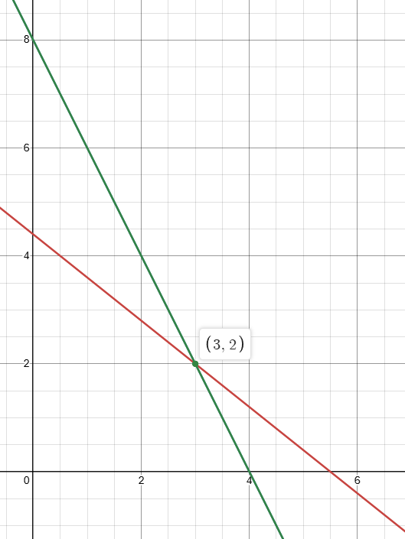









Solve
$$4x+5y=22$$
$$4x+2y=16$$
$$0+3y=6$$
$$y=2$$
Both values are positive
so, use subtraction
to eliminate x
Solve for x :
$$4x+2y=16$$
$$4x+2\left(2\right)=16$$
$$4x=12$$
$$x=3$$
POI is

Slide 8
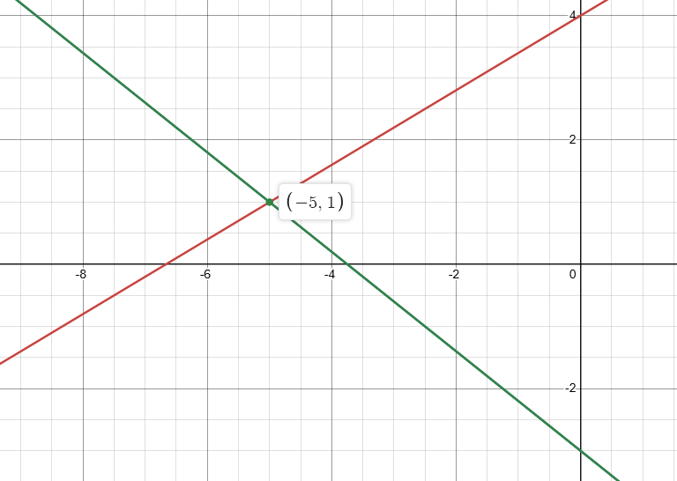










Solve
$$3x−5y=−20$$
$$4x+5y=−15$$
$$7x+0=−35$$
$$7x=−35$$
$$x=−5$$
Signs are different
so, use addition
to eliminate y
Solve for y :
$$3x−5y=−20$$
$$3\left(−5\right)−5y=−20$$
$$−5y=−5$$
$$y=1$$
POI is

