Slide 1

SOLVE LINEAR SYSTEMS USING SUBSTITUTION
FIND THE POI USING ALGEBRA – THE SUBSTITUTION METHOD
Step 1: Make sure both equations are in y = mx + b form; if not, write them in this form.
Step 2: Looking at the first equation; write down what is on the right hand side of the equation and then write = sign.
Step 3: Looking at the second equation; write down what is on the right hand side of the equation.
Step 4: Solve for x.
Step 5: Choose either one of the original equations and write it down.
Step 6: Substitute the x value from Step 4 into the equation.
Step 7: Solve for y.
Step 8: Write a concluding statement
$$∴$$
the solution is (x , y)

Slide 2
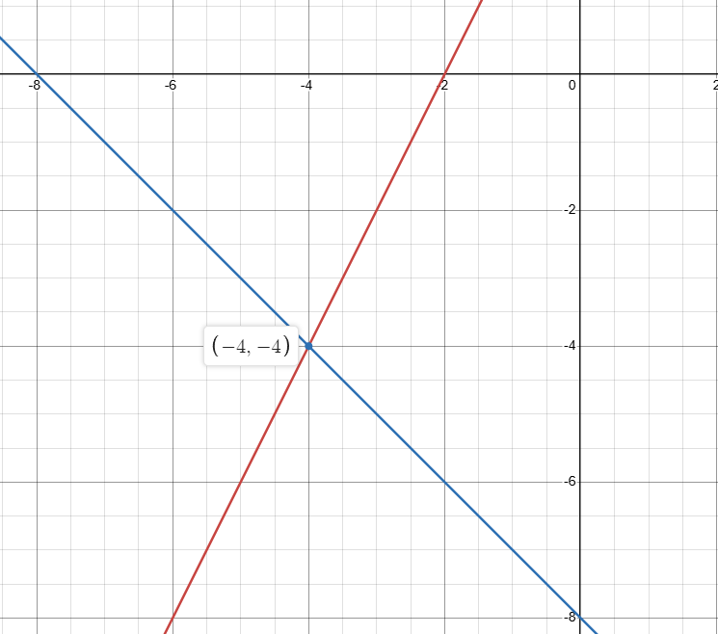







y = 2x + 4
y = – x – 8
Example #1:Solve the following linear system.
Solve for x:
$$2x+4=−x−8$$
L.S.
R.S.
L.S.
R.S.
$$2x+x=−8−4$$
-4
2(-4)+4
-4
-(-4)-8
4
-4
$$3x=−12$$
$$x=−4$$
Solve for y:
$$y=2\left(−4\right)+4$$
$$y=−4$$

Slide 3
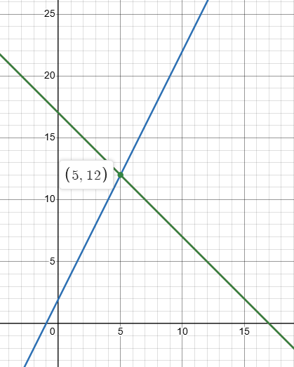











x + y = 17
4x – 2y = -4
Example #2:Solve the following linear system.
Solve for x:
L.S.
R.S.
L.S.
R.S.
$$x+y=17$$
$$4x−2y=−4$$
=(5)+(12)
= 17
=4(5)-2(12)
= -4
$$y=−x+17$$
$$−2y=−4x−4$$
=17
=20-24
= -4
$$y=2x+2$$
$$−x+17=2x+2$$
$$−3x=−15$$
$$x=5$$
Solve for y:
$$\left(5\right)+y=17$$
$$y=12$$

Slide 4


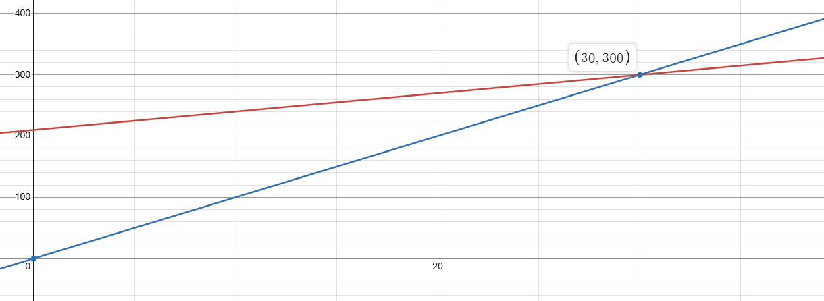





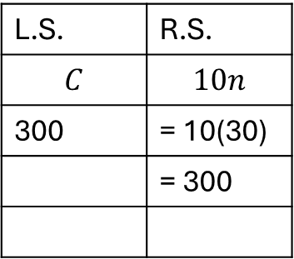

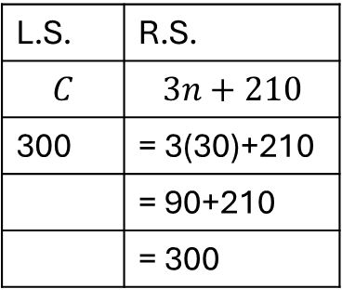


Example #3
Kate is selling T-shirts to raise money for diabetes research. The supplier charges a $210 design fee plus $3 per T-shirt.
Kate plans to sell the t-shirts for $10 each. How many T-shirts does Kate need to sell in order to break even?
Let C represent
the total cost for the t-shirts
L.S. | R.S.
$$C$$ | $$3n+210$$
300 | = 3(30)+210
 | = 90+210
 | = 300
L.S. | R.S.
$$C$$ | $$10n$$
300 | = 10(30)
 | = 300
Let n represent
the number of t-shirts
Solve for n:
$$C=3n+210$$
$$C=10n$$
$$3n+210=10n$$
$$7n=210$$
$$n=30$$
Solve for C:
Cost
$$C=10\left(30\right)$$
$$C=300$$
Number of t-shirts
Therefore, Kate must sell 30 t-shirts to break even.

