Slide 1

SOLVING LINEAR SYSTEMS USING SUBSTITUTION
The substitution method is another way to solve a linear system using ALGEBRA! The method requires you to write both equations in the slope y-intercept form.
$$y=mx+b$$
Recall: Solving a linear system means finding the
POINT OF INTERSECTION.
To find the POINT OF INTERSECTION (x, y):
FIRST find the x component (STEP 1)
THEN find the y component (STEP 2)
METHOD FOR STEP 1 – finding the x component of the POI (x, y)
*1* Make sure both equations are in y = mx + b form; if not, rearrange them into this form.
*2* Both equations equal y, so they are equal to each other!
So….set the right side of each equation equal to each other!!!.

Slide 2
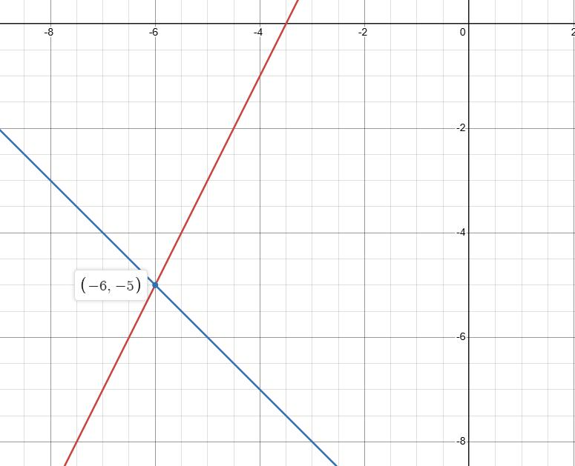



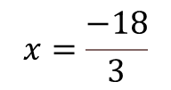





Here are two equations whose lines we are told will intersect.
y = 2x + 7
y = – x – 11
This means that at some point the x and y values for these two lines will be the same
at the point of intersection.
Since they are both equal to y we can also say they are equal to each other.
$$2x+7=−x−11$$
Now we can solve for the value of
$$x$$
$$2x+x=−11−7$$
$$3x=−18$$
$$x=\frac{−18}{3}$$
$$x=−6$$
Once we have a value for
$$x$$
we can sub that value
back into one of the original equations to get a value for y
$$y=2\left(−6\right)+7$$
$$y=−5$$

Slide 3
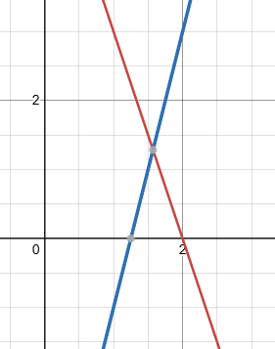

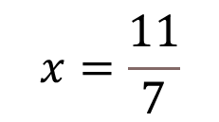


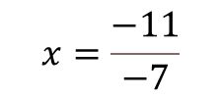







Solve for
$$x$$
$$6x+2y=12$$
intersects with
$$4x−y=5$$
$$2y=−6x+12$$
$$−y=−4x+5$$
$$y=−3x+6$$
$$y=4x−5$$
Therefore
$$−3x+6=4x−5$$
$$−3x−4x=−5−6$$
$$−7x=−11$$
$$x=\frac{−11}{−7}$$
$$x=\frac{11}{7}$$

Slide 4
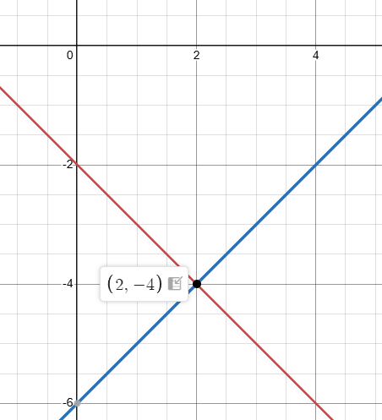









x + y = -2
intersects with
x – y = 6
$$y=−x−2$$
$$−y=−x+6$$
$$y=x−6$$
Therefore
$$−x−2=x−6$$
$$−x−x=−6+2$$
$$2x=−4$$
$$x=2$$
Sub the value of x back into one of the original equations…
$$\left(2\right)+y=−2$$
$$y=−4$$

Slide 5












METHOD FOR STEP 2 – finding the y component of the POI (x, y)
*1* Use the equation of the line in the y = mx + b form
*2* Substitute the value of x (from STEP 1) into that equation
*3* Solve for y
EXAMPLES - Solve the following equations by substituting in for the x value
a) y = x + 5 when x = 2
b) y = 6x – 3 when x = – 5
$$y=\left(2\right)+5$$
$$y=6\left(−5\right)−3$$
$$y=7$$
$$y=−33$$
c) y = 3x + 8 when x = 7
d) y = – 9x – 25 when x = – 4
$$y=3\left(7\right)+8$$
$$y=−9\left(−4\right)−25$$
$$y=29$$
$$y=11$$

