Slide 1
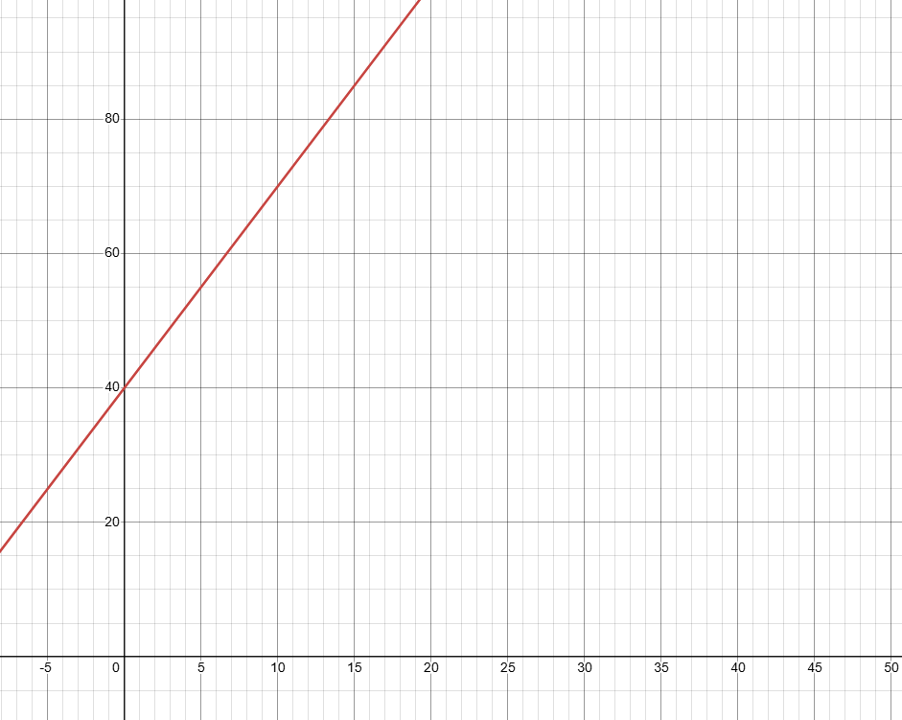
speed
cost
etc.
fixed value
units sold
distance
etc.

Slide 2


SOLVE AND INTERPRET LINEAR SYSTEMS…BY GRAPHING
Example:
Galaxy Video rents a game machine for $10 and video games for $3 each.
4-Less Video rents a game machine for $7 and video games for $4 each
Write an equation to represent the cost of renting one game machine and video games at each store. Define your variables.
Let C be the cost
Let g be the number of video games rented.
$$C=3g+10$$
$$C=4g+7$$
Create a table of values for each equation. (Use a maximum number of 6 video games.)
g | C=3g+10 | Plot
0 | C=3(0)+10 =10 | (0,10)
2 | C=3(2)+10 =16 | (2,16)
4 | C=3(4)+10 =22 | (4,22)
6 | C=3(6)+10 =28 | (6,28)
g | C=4g+7 | Plot
0 | C=4(0)+7 = 7 | (0,7)
2 | C=4(2)+7 = 15 | (2,15)
4 | C=4(4)+7 = 23 | (4,23)
6 | C=4(6)+7 = 31 | (6,31)

Slide 3
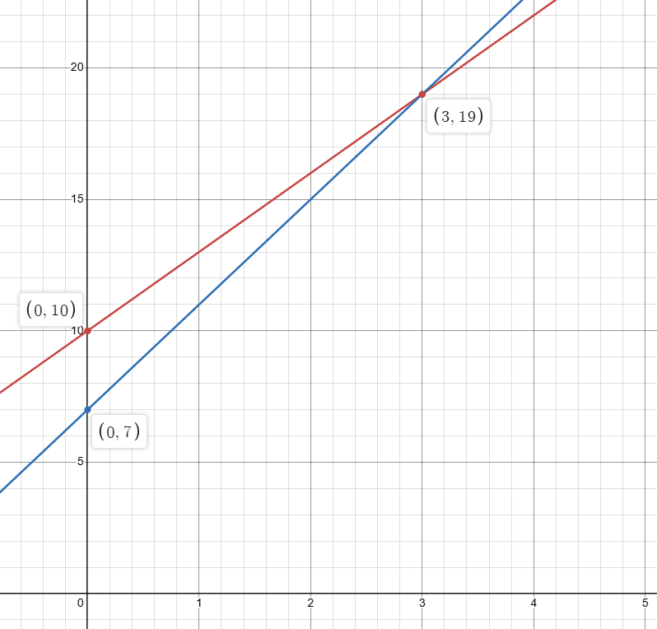
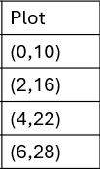
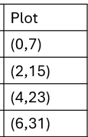
Galaxy Video
POI represents
games rented when
cost is the same.
4-Less Video
cost
For the first 2 games
4-Less Video is cheaper
For 3 games they are
the same.
More than 3 games,
Galaxy Video is cheaper
# of games rented

Slide 4
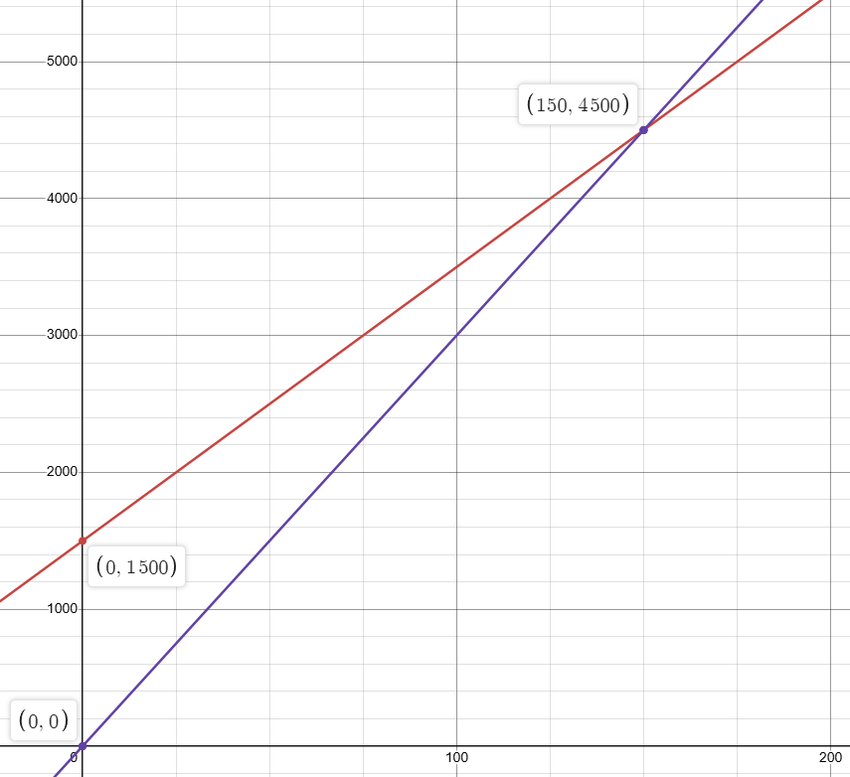
Example
Each graph compares the rental costs of two halls. For each graph:
  Describe what the point of intersection represents.
  For how many guests is each hall cheaper? Explain
POI
At 150 Guests the two halls cost the
same to rent. $4500.00
If guest number is under 150, Hall C
is cheaper.
With more than 150 guests, Hall D is
cheaper.
Cost($)
Hall D
Hall C
Number of Guests

Slide 5
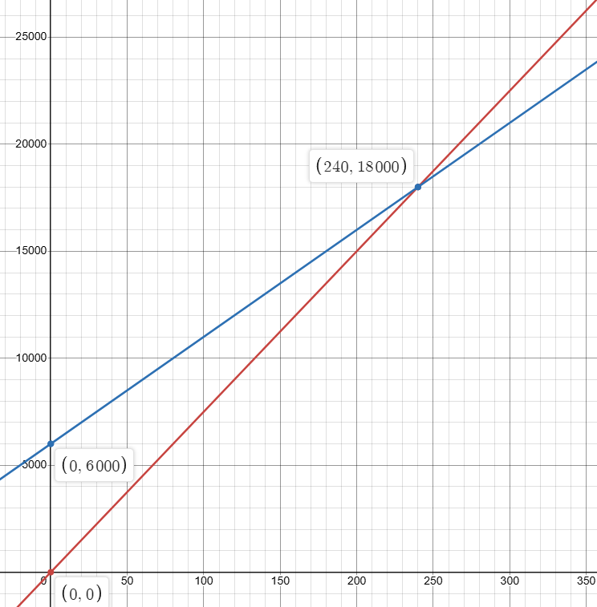
POI
At 240 Guests the two halls cost the
same to rent. $18000.00
If guest number is under 240, Hall E
is cheaper.
With more than 240 guests, Hall F is
cheaper.
Hall F
Cost($)
Hall E
Number of Guests

Slide 6
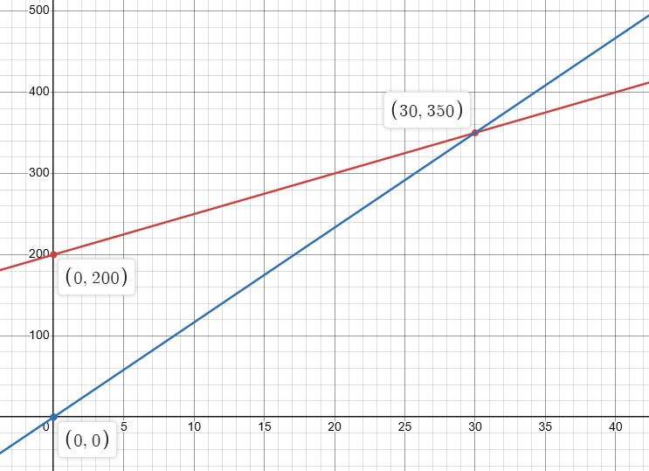
This graph represents the costs to produce and sell pizza. Graph A represents the daily cost to produce pizza. Graph B represents the daily income from the sale of pizzas.
Describe what the point of intersection represents
Cost of Pizzas
At 30 pizzas produced, the daily
cost and the daily profit is the same.
A
How many pizzas must be sold before
there is a profit (that is, the income is
greater than the cost)? Explain.
B
Cost and Income($)
31 pizzas must be sold before
a profit is made.
Number of Pizzas

