Slide 1
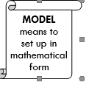
MODELLING WORD PROBLEMS USING LINEAR SYSTEMS
To MODEL a word problem using a system of linear equations you must:
____________ your _________________ using “________” statements
____________ each of your _________________
Declare
variables
“Let”
Create
equations
TYPES OF LINEAR SYSTEM PROBLEMS
In our class there are TWO types of linear system problems that can be modelled.
FIRST
is when you have a ______________ SCENARIO under _______________ conditions.
single
different

Slide 2
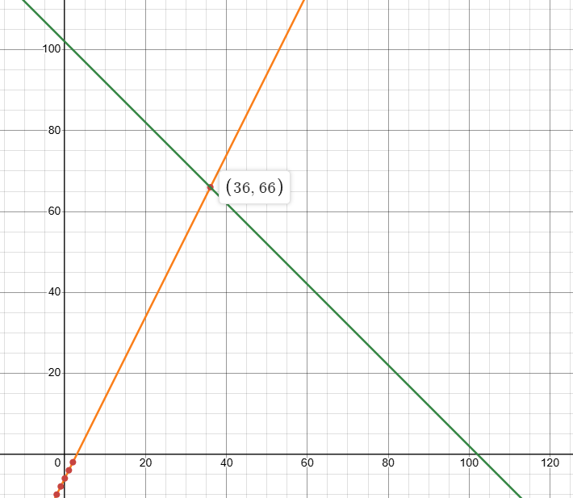


Example:
Jason weighs six kilograms less than twice Bill’s weight.
If the sum of their weights is 102 kilograms, how much does each person weigh?
Let j be Jason’s weight
Let b be Bill’s weight
1.
$$j=2b−6$$
Jason
2.
$$j+b=102$$
Bill

Slide 3
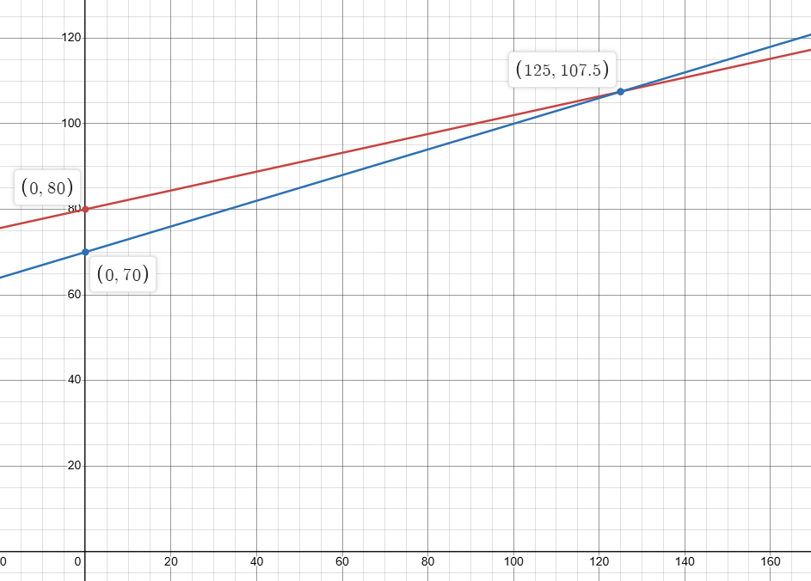


SECOND
is when you have _________ SCENARIOS under __________________ conditions.
two
similar
Example:
Karl’s Towing charges $80 plus $0.22/km. Bev’s Towing charges $70 plus $0.30/km.
Write a linear system to represent this problem. Which towing company would you use? Explain.
Let C be the total cost of towing.
Let k be the number of km towed
1.
$$C=0.22k+80$$
2.
$$C=0.30k+70$$
cost
km

Slide 4
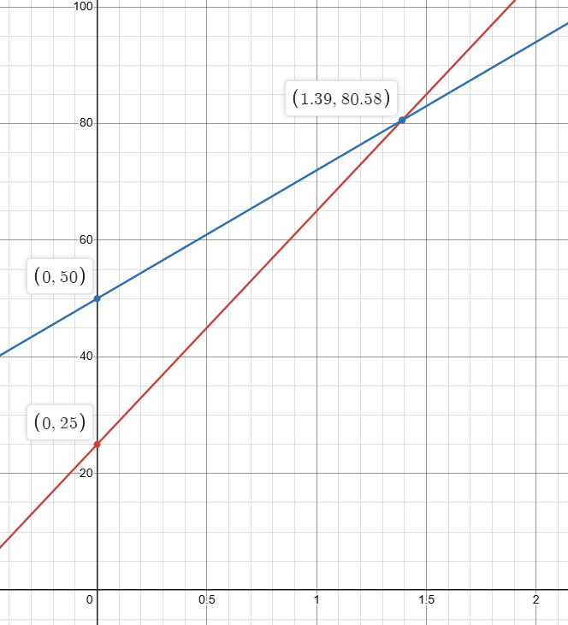


Jill makes two types of quilts.
The first type costs $25 for fabric and $40 per hour for hand quilting.
The second type costs $50 for fabric and $22 per hour for machine quilting.
For what number of hours are the costs the same? MODEL this problem.
Let C be cost for a quilt
Let h be the number of hours needed
$$C=40h+25$$
$$C=22h+50$$
cost
hours

Slide 5
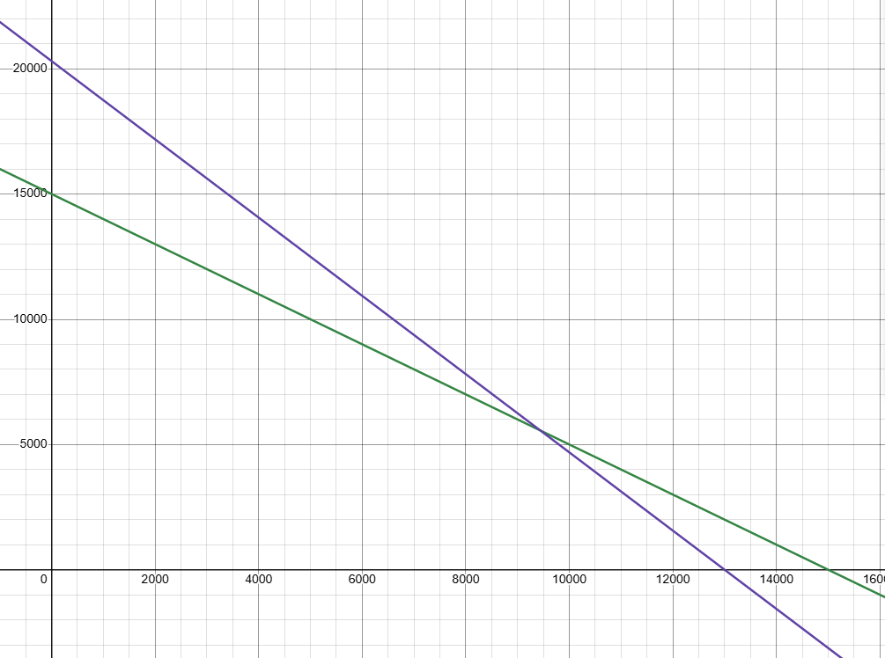


A band held a concert in its hometown. A total of 15 000 people attended.
The tickets cost $8.00 per student and $12.50 per adult.
The concert took in a total of $162 500.
How many adults came to the concert? MODEL this problem.
approx. 9440 adults attended
Let x be the number of adult tickets sold
Let y be the number of student tickets sold
$$x+y=15000$$
$$12.5x+8y=162500$$
students
adults

