Slide 1
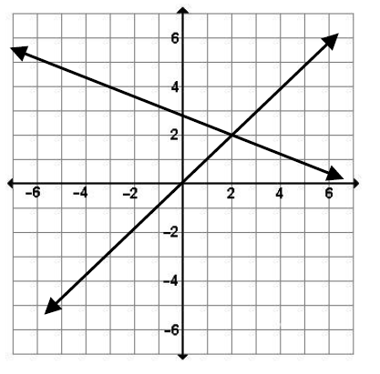
Some problems are solved by graphing linear equations on the Cartesian Plane and finding where they cross (i.e., finding the point of intersection).
The point of intersection is called the solution of a linear system of equations.
State the solution of each of the following linear systems:
( 2 , 2 )

Slide 2
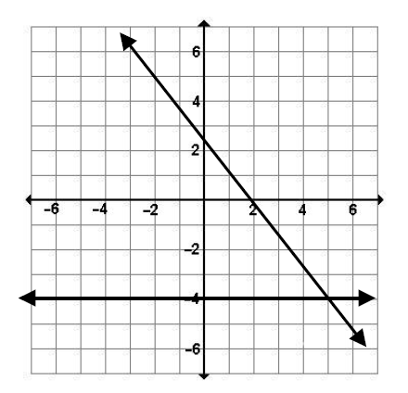
( 5 , -4 )

Slide 3
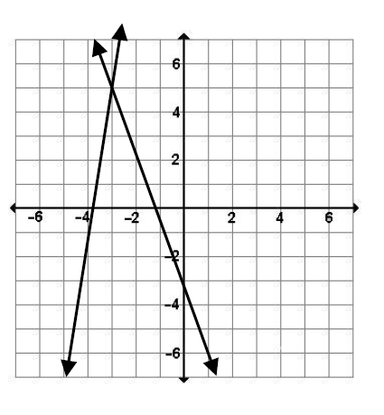
( -3 , 5 )

Slide 4
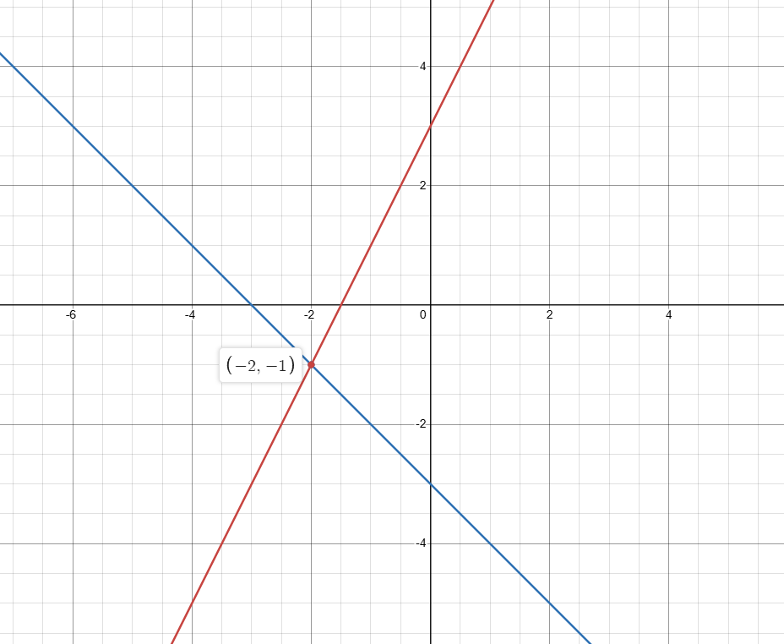


EXAMPLE: Solve the following linear system:
Both the Girl Guides and Boy Scouts are hiking through Algonquin Park. The Girl Guides are travelling in a direction that is represented by the equation y = 2x + 3. The Boy Scouts are travelling in a direction that is represented by the equation
y = –x – 3. Find the coordinates of the point where their paths will cross.
Step 1: Plot both equations on the graph.
Step 2: Find the point of intersection.
Boy Scouts
Girl Scouts
$$y=−x−3$$
$$y=2x+3$$

Slide 5
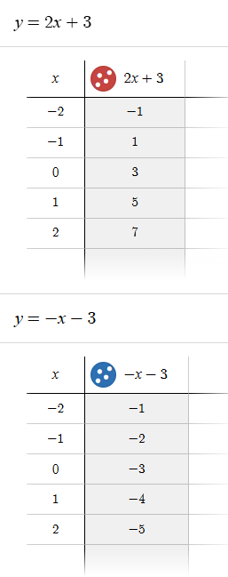

Slide 6
SOLVING LINEAR SYSTEMS BY GRAPHING
A linear system is represented by _____________________________________________.
The Point of Intersection (_____) of the two lines is the ______________ of a linear system of equations.
The POI _______________________________ will make each equation ____________ when the (___, ___) values are _____________________________ into each equation.
You can CHECK to see if your solution is correct by _____________________ the solution back into your equations to see if the _________ of the equation equals the ___________.
at least two linear equations(lines)
POI
Solution
point of intersection
true
x
y
substituted
substituting
L.S.
R.S.

Slide 7






Substituting a solution to check if L.S. equals R.S.
In the scout example we established that the point of intersection was ( -2 , -1 )
for the two equations
$$y=2x+3$$
and
$$y=−x−1$$
$$−1=2\left(−2\right)+3$$
$$−1=−\left(−2\right)−1$$
$$−1=−1$$
$$−1=−1$$

Slide 8
There are several ways to find the solution to a linear system of equations.
1) Graphing
2) Substitution
3) Elimination

Slide 9
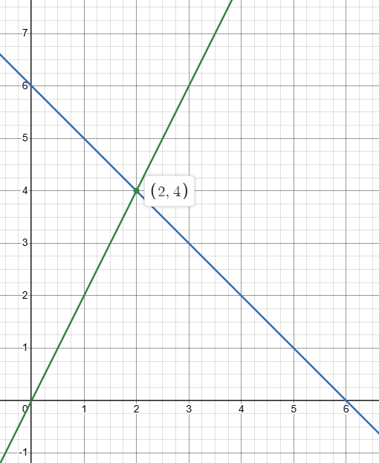







Solve each linear system graphically.
Remember to rearrange the equations, if necessary, into the y = mx + b form first.
Example 1
x + y = 6 and 2x – y = 0
$$y=−x+6$$
$$−y=−2x+0$$
$$m=−1$$
$$y=2x+0$$
$$b=6$$
$$m=2$$
$$b=0$$
POI is ( 2 , 4 )

Slide 10
Check: ( 2 , 4 )
x + y = 6 2x – y = 0
L.S. | R.S.
= x + y | = 6
= (2) + (4)
= 6
L.S. | R.S.
= 2x - y | = 0
= 2(2)-(4)
= 4 - 4
=0
L.S. = R.S.
L.S. = R.S.

Slide 11
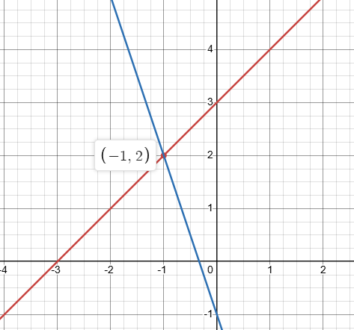





Example 2
y = x + 3 and 3x + y + 1 = 0
$$m=1$$
$$y=−3x−1$$
$$b=3$$
POI is ( -1 , 2 )
$$m=−3$$
$$b=−1$$
Check: ( -1 , 2 )
y = x + 3 3x + y + 1 = 0
L.S. | R.S.
= 2 | = (-1) + 3
 | = 2
L.S. | R.S.
= 3(-1) + (2) + 1 | = 0
= -3 + 3
= 0
L.S. = R.S.
L.S. = R.S.

Slide 12
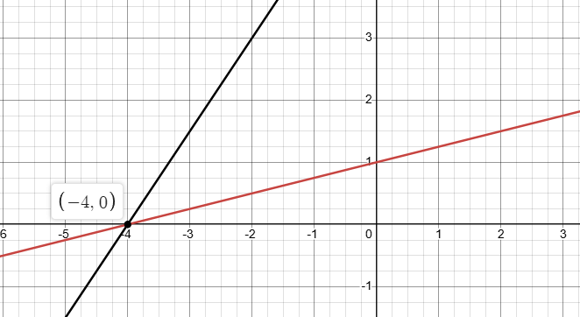
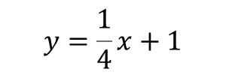



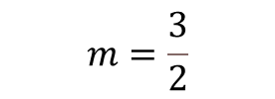
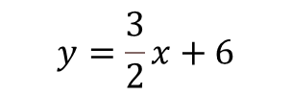

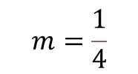
Example 3
2y - 3x = 12 and -x + 4y = 4
$$2y=3x+12$$
$$4y=x+4$$
$$y=\frac{3}{2}x+6$$
$$y=\frac{1}{4}x+1$$
$$m=\frac{1}{4}$$
$$b=1$$
$$m=\frac{3}{2}$$
$$b=6$$
POI is ( -4 , 0 )
Check: ( -4 , 0 )
2y - 3x = 12 -x + 4y = 4
L.S. | R.S.
= 2(0) -3(-4) | = 12
=12
L.S. | R.S.
= -(-4)+4(0) | = 4
= 4
L.S. = R.S.
L.S. = R.S.

