Slide 1

STANDARD FORM
Standard form of a linear equation is written in the form of
Ax + By + C = 0
Graphing from standard form is trickier than graphing from slope, y-intercept form
SO…You can change a standard form equation into slope y-intercept form by
rearranging the equation to look like ___________________.
$$y=mx+b$$
But one thing it's very good at is finding the x- and y-intercepts of a line.
The x-intercept occurs when y=0. Similarly, the y-intercept occurs when x=0. So to find these, you just need to plug in x=0 and solve for y, then plug in y=0 and solve for x.

Slide 2
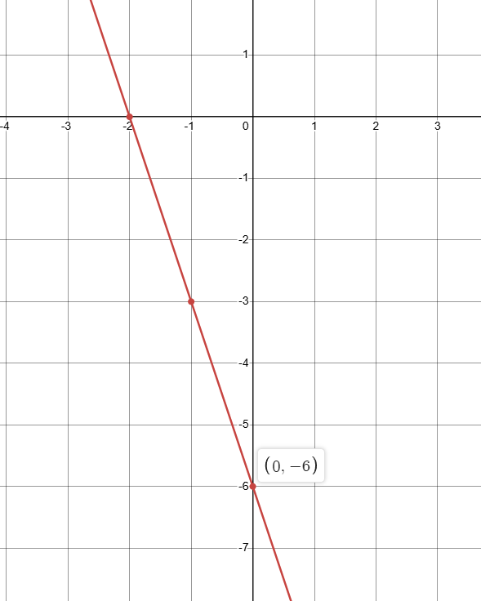






2.
$$−3x−y−6=0$$
$$−y=3x+6$$
$$y=−3x−6$$
$$m=−3$$
$$b=−6$$
$$y=−3x−6$$

Slide 3
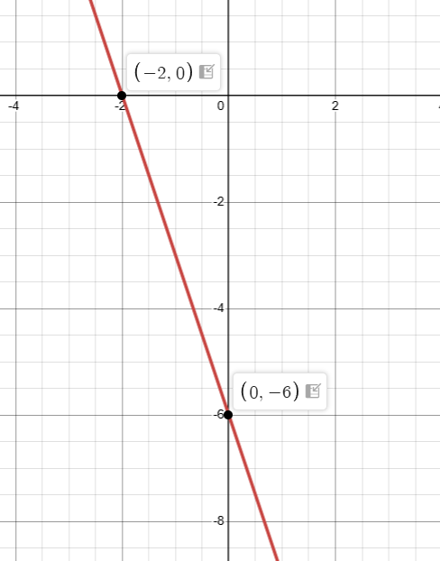
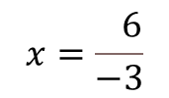






Using the Standard Form to Determine Intercepts
$$−3x−y−6=0$$
To find out where this graph crosses the y axis, set x to 0
$$−3\left(0\right)−y−6=0$$
$$−y=6$$
$$y=−6$$
The graph crosses the y-axis at the point 0,-6
To find out where this graph crosses the x axis, set y to 0
$$−3x−\left(0\right)−6=0$$
$$−3x=6$$
$$x=\frac{ 6}{−3}$$
The graph crosses the x-axis at the point -2, 0
Setting x to zero gives you the y-intercept.
Setting y to zero gives you the x-intercept.

Slide 4

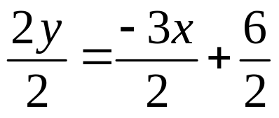
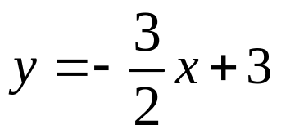

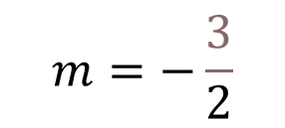


Example: Change
to slope y-intercept form.
$$3x+2y−6=0$$
$$2y=−3x+6$$
What is the slope & y-intercept?
$$m=−\frac{3}{2}$$

Slide 5










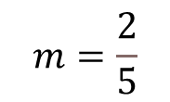
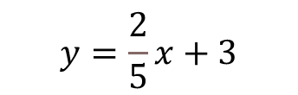

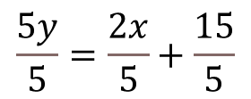

Rearrange the following equations from standard form to slope, y-intercept form.
$$x+y−3=0$$
$$x−y=0$$
$$−2x+5y−15=0$$
$$y=−x+3$$
$$x=y$$
$$5y=2x+15$$
$$y=x$$
$$\frac{5y}{5}=\frac{2x}{5}+\frac{15}{5}$$
$$y=\frac{2}{5}x+3$$
$$m=−1$$
$$b=3$$
$$m=1$$
$$b=0$$
$$m=\frac{2}{5}$$
$$b=3$$

Slide 6
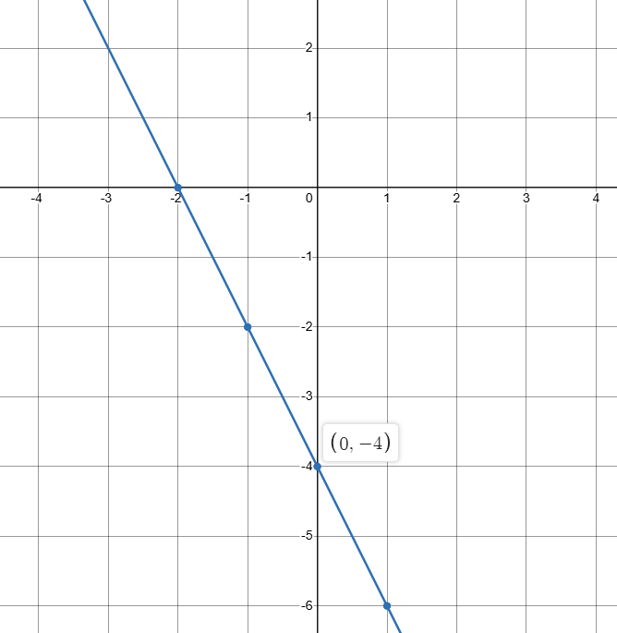





CHANGE FROM STANDARD FORM TO SLOPE Y-INTERCEPT FORM, THEN GRAPH
1.
$$2x+y+4=0$$
$$y=−2x−4$$
$$m=−2$$
$$b=−4$$
$$y=−2x−4$$

Slide 7
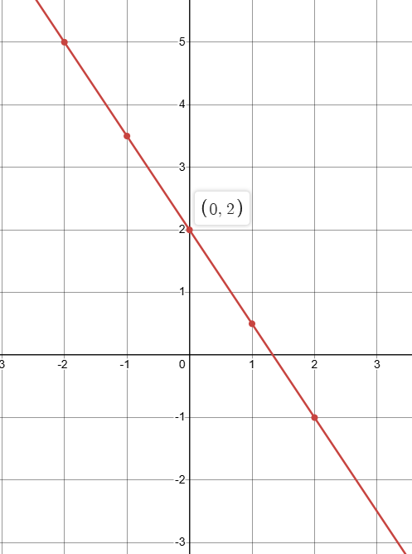



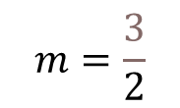
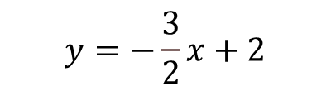
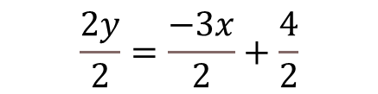
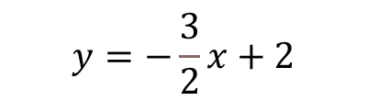
3.
$$3x+2y−4=0$$
$$2y=−3x+4$$
$$\frac{2y}{2}=\frac{−3x}{2}+\frac{4}{2}$$
$$y=−\frac{3}{2}x+2$$
$$y=−\frac{3}{2}x+2$$
$$m=\frac{3}{2}$$
$$b=2$$

