Slide 1






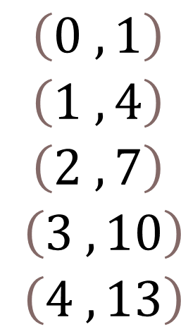
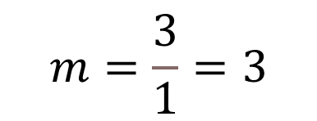

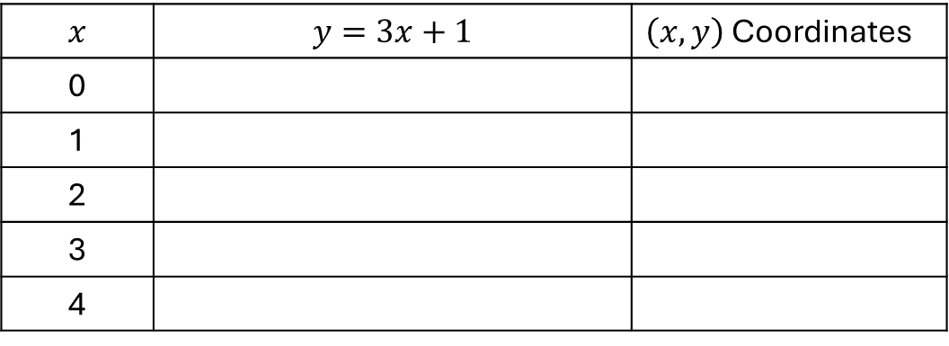

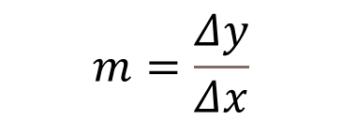
$$\begin{matrix}\left(0 , 1\right) \\ \left(1 , 4\right) \\ \left(2 , 7\right) \\ \left(3 , 10\right) \\ \left(4 , 13\right)\end{matrix}$$
$$x$$ | $$y=3x+1$$ | $\left(x,y\right)$ Coordinates
0
1
2
3
4
1
3
$$y=3(0)+1$$
1
( 0 , 1 )
$$y=3(1)+1$$
4
( 1 , 4 )
1
3
$$y=3(2)+1$$
7
( 2 , 7 )
( 3 , 10 )
1
3
$$y=3(3)+1$$
10
$$y=3(4)+1$$
13
( 4 , 13 )
3
1
As
$$x$$
changes by 1,
$$y$$
changes by 3
The symbol for change is math is the symbol
$$Δ$$
pronounced Delta
Looking back at our definitions at the top of the page we can state the change in y
over the change in x is equal to our slope
$$m=\frac{Δy}{Δx}$$
$$m=\frac{3}{1}=3$$

Slide 2


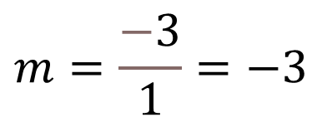


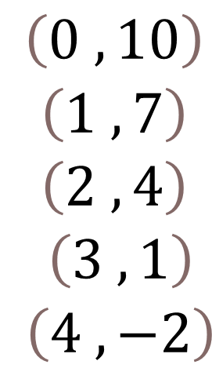

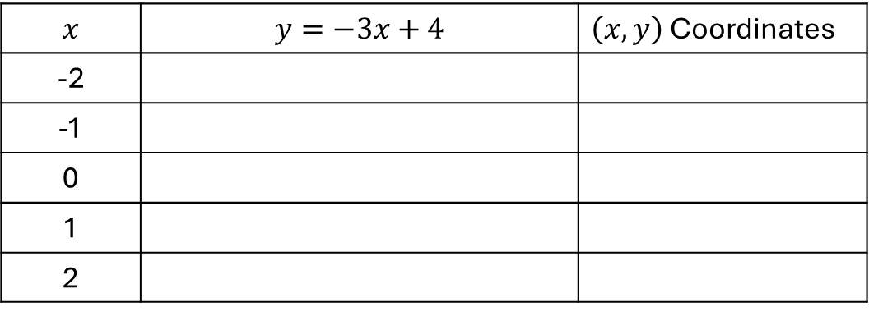

$$\begin{matrix}\left(0 , 10\right) \\ \left(1 , 7\right) \\ \left(2 , 4\right) \\ \left(3 , 1\right) \\ \left(4 , −2\right)\end{matrix}$$
$$x$$ | $$y=−3x+4$$ | $\left(x,y\right)$ Coordinates
-2
-1
0
1
2
1
-3
$$y=−3(0)+4$$
10
( 0 , 1 )
$$y=−3(1)+4$$
7
( 1 , 4 )
1
-3
$$y=−3(2)+4$$
4
( 2 , 7 )
( 3 , 10 )
1
-3
$$y=−3(3)+4$$
1
$$y=−3(4)+4$$
-2
( 4 , 13 )
-3
1
$$m=\frac{Δy}{Δx}$$
$$m=\frac{−3}{1}=−3$$

Slide 3
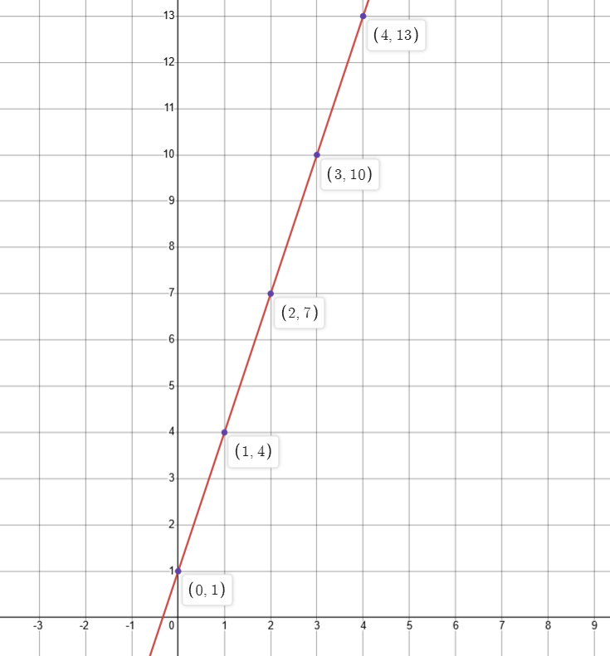
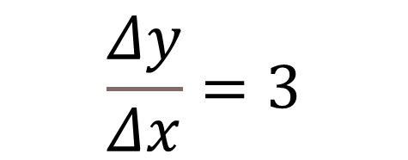
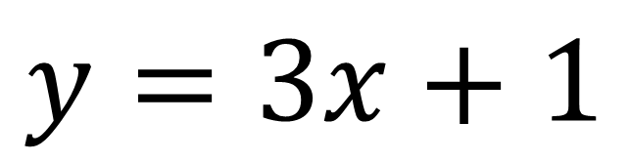


$$y=3x+1$$
$$\frac{Δy}{Δx}=3$$
There is a 3-unit shift in
for every 1-unit shift in
$$y$$
$$x$$

Slide 4
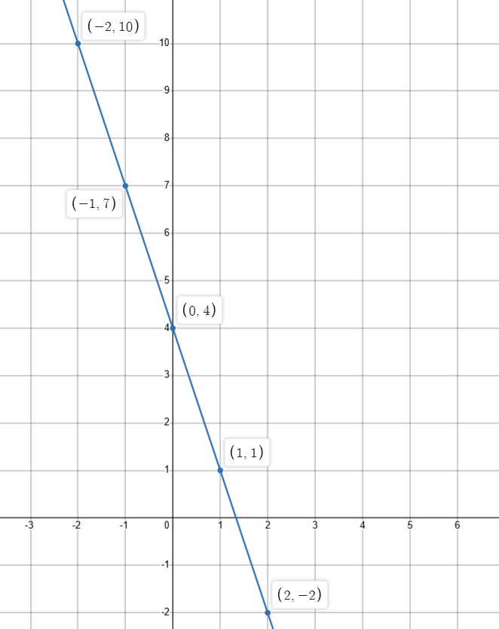
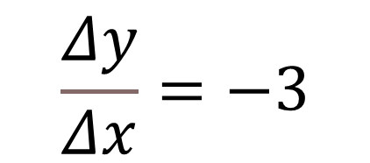


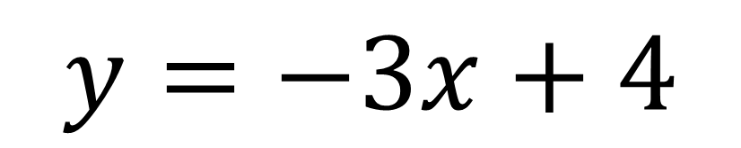
$$y=−3x+4$$
$$\frac{Δy}{Δx}=−3$$
$$y$$
There is a negative 3-unit shift in
for every 1-unit shift in
$$x$$

Slide 5
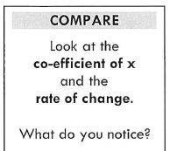
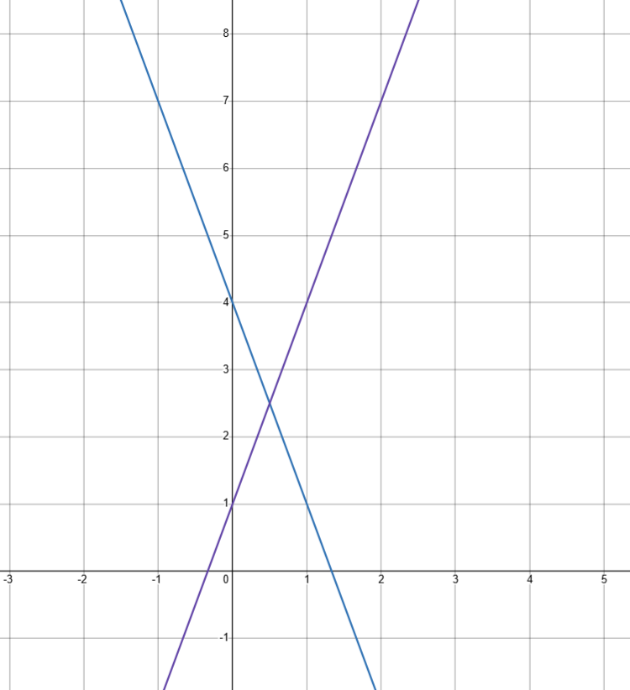
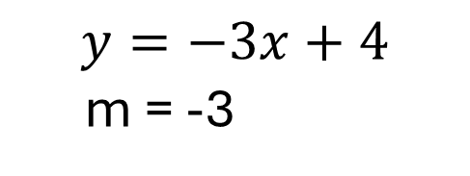
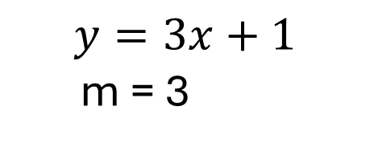
$$y=−3x+4$$
m = -3
$$y=3x+1$$
m = 3
Answer: The slope of the
equation is the same as the
x-coefficient.

Slide 6


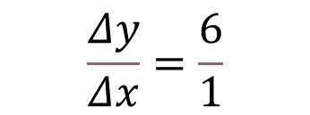
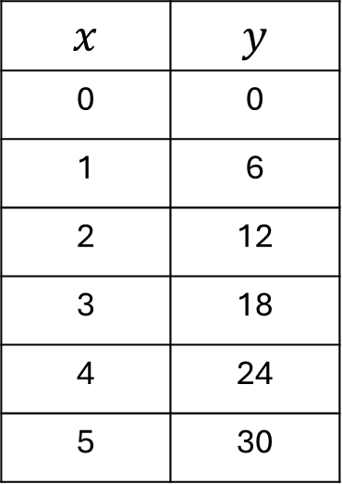



Change in
$$x$$
Change in
$$y$$
$$x$$ | $$y$$
0 | 0
1 | 6
2 | 12
3 | 18
4 | 24
5 | 30
$$Δx$$
$$Δy$$
1
6
1
6
1
6
$$\frac{Δy}{Δx}=\frac{6}{1}$$
1
6
1
6
$$m=6$$

Slide 7









$$y=−3x+7$$
$$−2x+y=6$$
$$y−3x=7x+2$$
$$y=7x+3x+2$$
$$m=−3$$
$$y=2x+6$$
$$m=2$$
$$y=10x+2$$
$$m=10$$

Slide 8
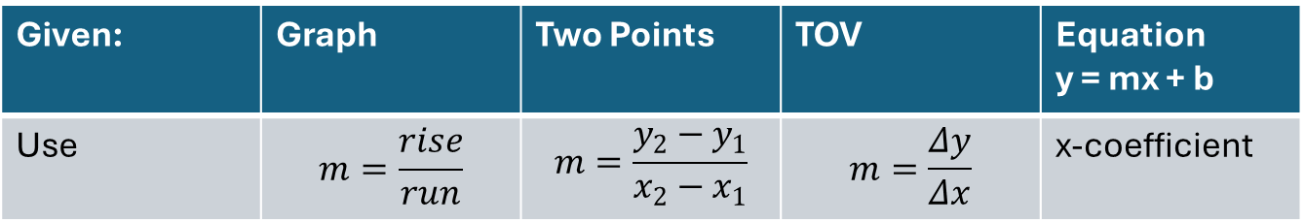
4 Different Ways to Determine Slope
Given: | Graph | Two Points | TOV | Equation y = mx + b
Use | $$m=\frac{rise}{run}$$ | $$m=\frac{y_{2}−y_{1}}{x_{2}−x_{1}}$$ | $$m=\frac{Δy}{Δx}$$ | x-coefficient

Slide 9
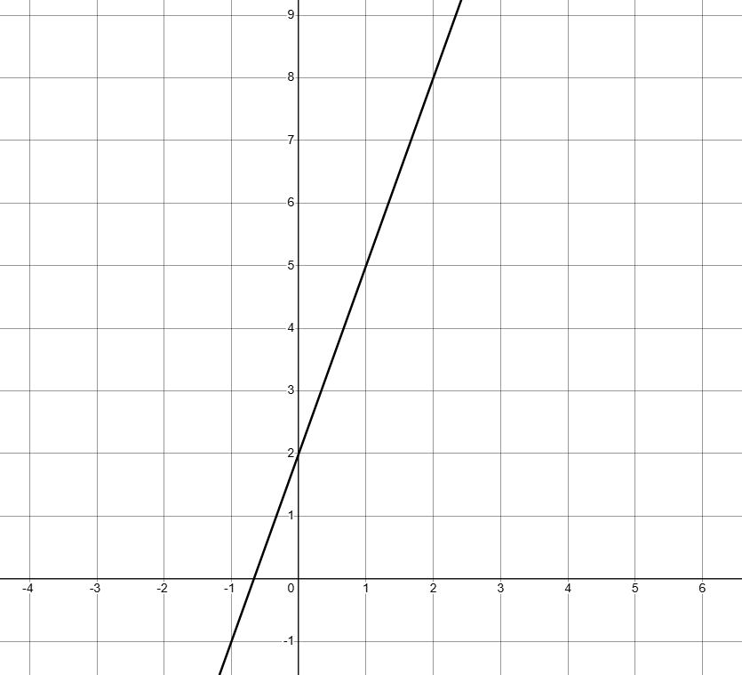
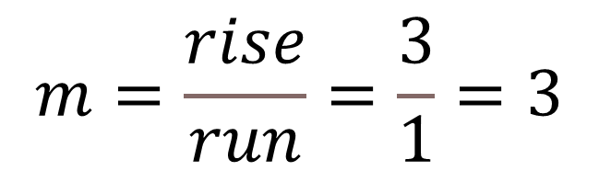
Given a Graph
$$m=\frac{rise}{run}=\frac{3}{1}=3$$
rise=3
run=1

Slide 10
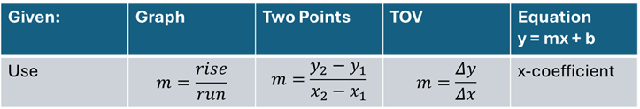
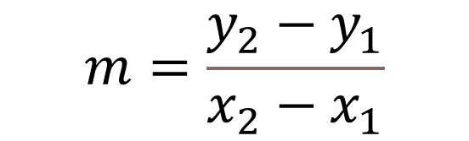
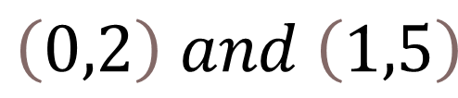
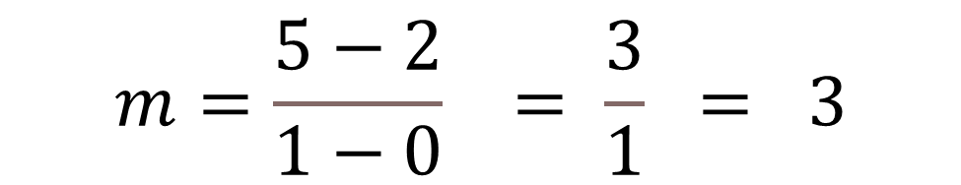
Given 2 Points
$$\left(0,2\right) and \left(1,5\right)$$
$$m=\frac{y_{2}−y_{1}}{x_{2}−x_{1}}$$
$$m=\frac{5−2}{1−0} = \frac{3}{1} = 3$$

Slide 11
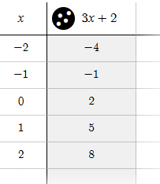



Given A Table of Values(TOV)
$$y$$
1
3
3
$$\frac{Δy}{Δx}=\frac{3}{1}$$
1
1
3
1
3
$$m=3$$

Slide 12
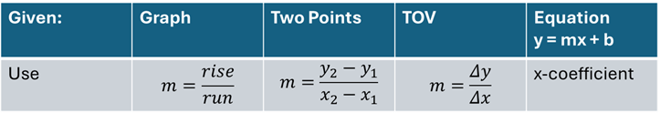
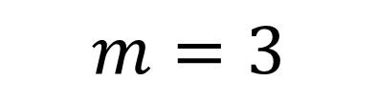
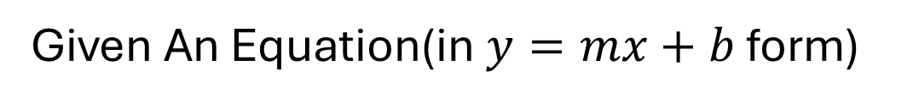
Given An Equation(in $y=mx+b$ form)
x-coefficient
y = 3x + 2
$$m=3$$

Slide 13
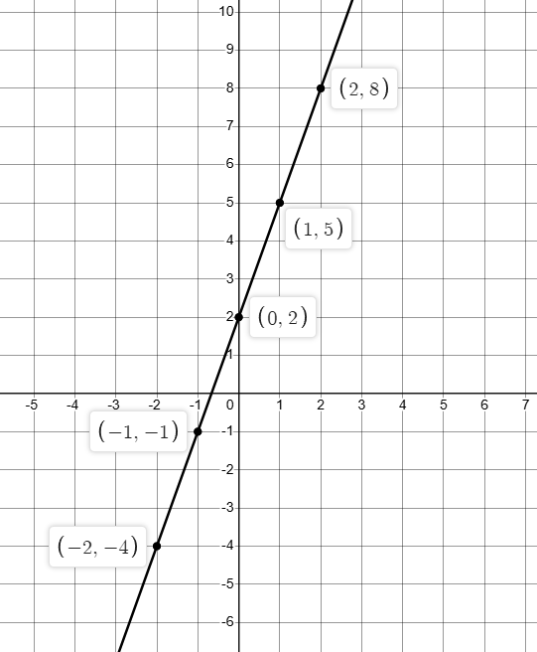
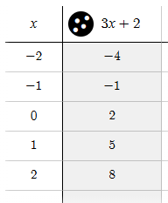
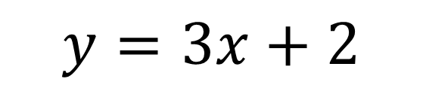
Did you notice….
all of the examples in the last 5
slides were based on the same equation with a slope of 3
$$y=3x+2$$

