Slide 1
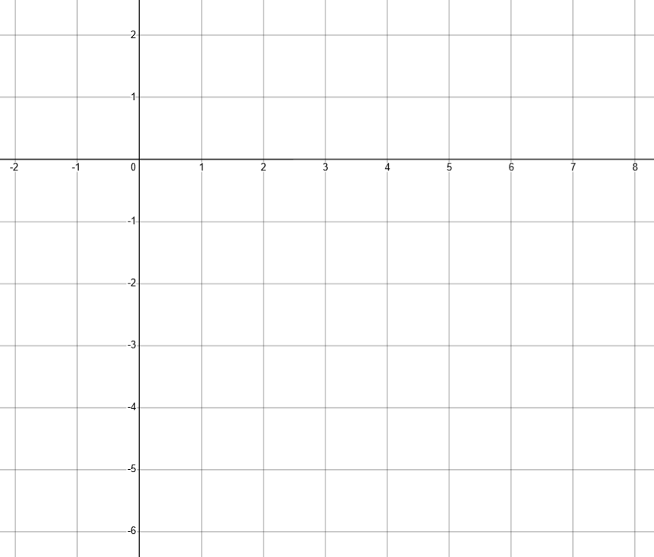
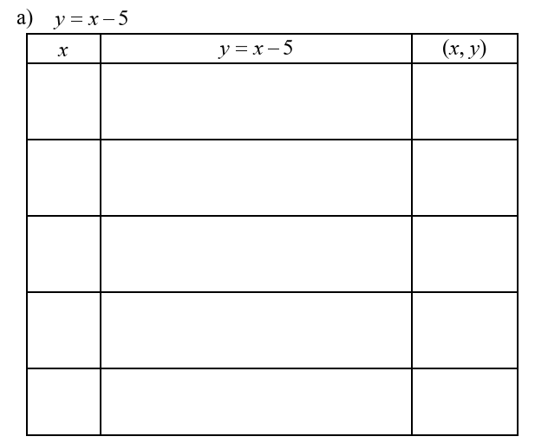










Graphing Lines From A Table Of Values
Plotting and connecting ordered pairs creates a graph. We can use an equation, with given values of x, to determine values of y. To do this, we substitute the value of x into the
equation, then calculate the value of y. Then, we can graph the equation by connecting the
coordinates with a line.
-1
$$y=\left(−1\right)−5$$
-6
$$\left(−1,−6\right)$$
0
$$y=\left(0\right)−5$$
-5
$$\left(0,−5\right)$$
1
$$y=\left(1\right)−5$$
-4
$$\left(1,−4\right)$$
2
$$y=\left(2\right)−5$$
-3
$$\left(2,−3\right)$$
7
$$y=\left(7\right)−5$$
2
$$\left(7,2\right)$$

Slide 2
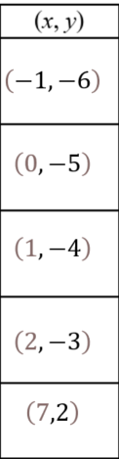
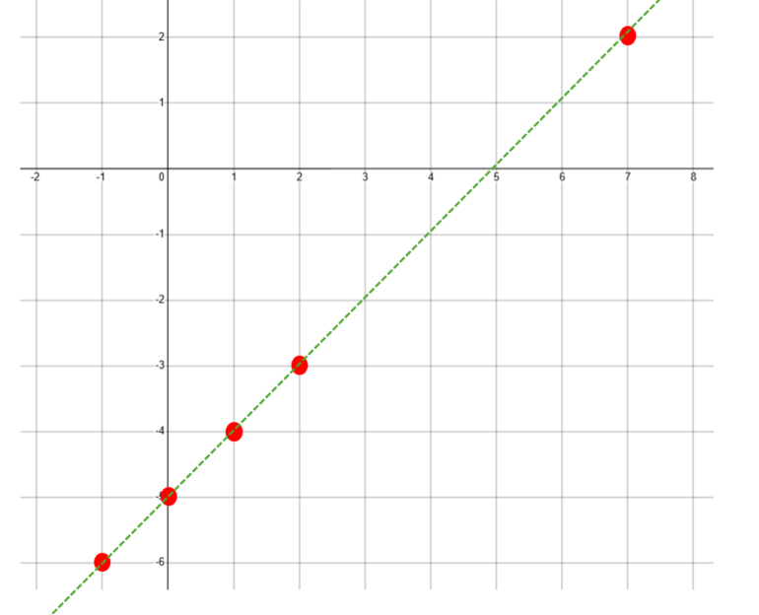







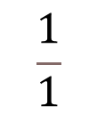


To calculate slope of
$$y=x−5$$
We can select any two ordered pairs that we have and
plug them into the formula for calculating slope.
$$−4$$
$$−\left(−5\right)$$
$$m=$$
$$1$$
$$− \left(0\right)$$
$$\frac{1}{1}$$
$$m=$$
$$m=$$
$$1$$

Slide 3
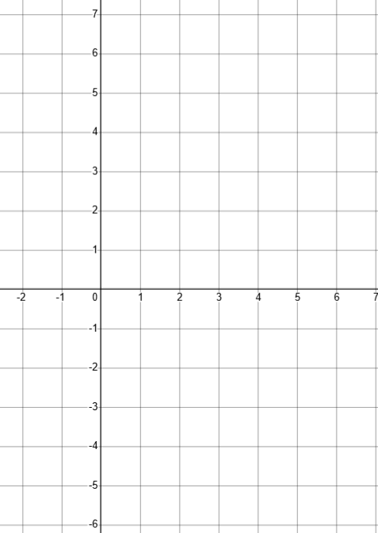











$$y=−3x+4$$
-1
$$y=−3\left(−1\right)+4$$
7
$$\left(−1, 7\right)$$
0
$$y=−3\left(0\right)+4$$
4
$$\left(0, 4\right)$$
1
$$y=−3\left(1\right)+4$$
1
$$\left(1, 1\right)$$
2
$$y=−3\left(2\right)+4$$
-2
$$\left(2,−2\right)$$
3
$$y=−3\left(3\right)+4$$
-5
$$\left(3, −5\right)$$

Slide 4
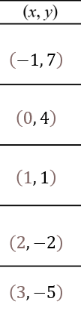





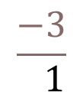


To calculate slope of
$$y=−3x+4$$
We can select any two ordered pairs that
we have and plug them into the formula
for calculating slope.
$$1$$
$$−\left(4\right)$$
$$m=$$
$$1$$
$$− \left(0\right)$$
$$\frac{−3}{ 1}$$
$$m=$$
$$m=$$
$$−3$$

Slide 5
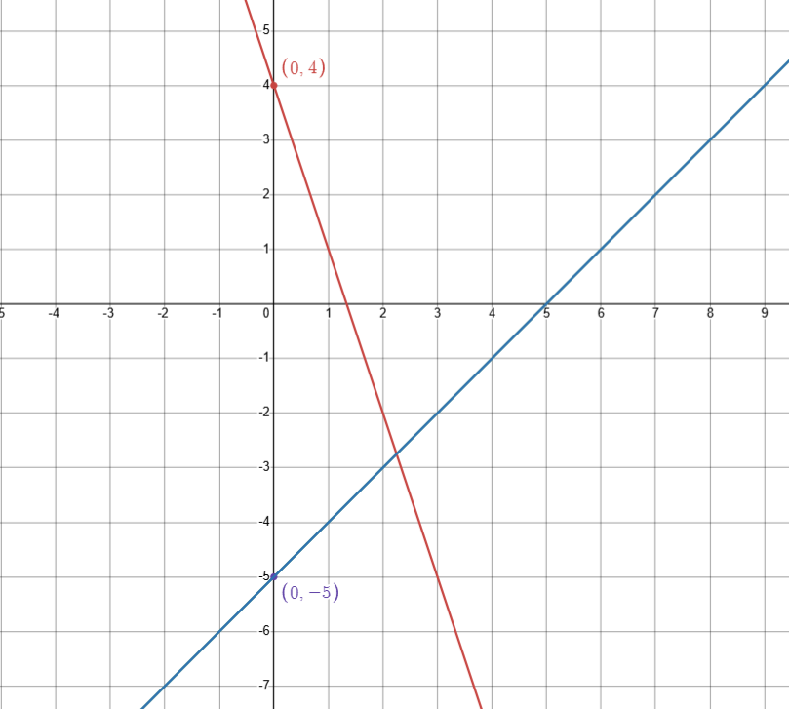











Emerging Patterns From
$$y=mx+b$$
$$y=−3x+4$$
has a slope of -3 which is the same as the
$$y=−3x+4$$
$$x−$$
coefficient in the equation.
The
$$b$$
element in this equation is 4
which happens to be the
$$y$$
value
of the point at which the graph crosses
the y axis
$$y=x−5$$
has a slope of 1 which is the same as the
$$x−$$
coefficient in the equation.
The
$$b$$
element in this equation is -5
which happens to be the
$$y$$
value
$$y=x−5$$
of the point at which the graph crosses
the y axis

