Slide 1
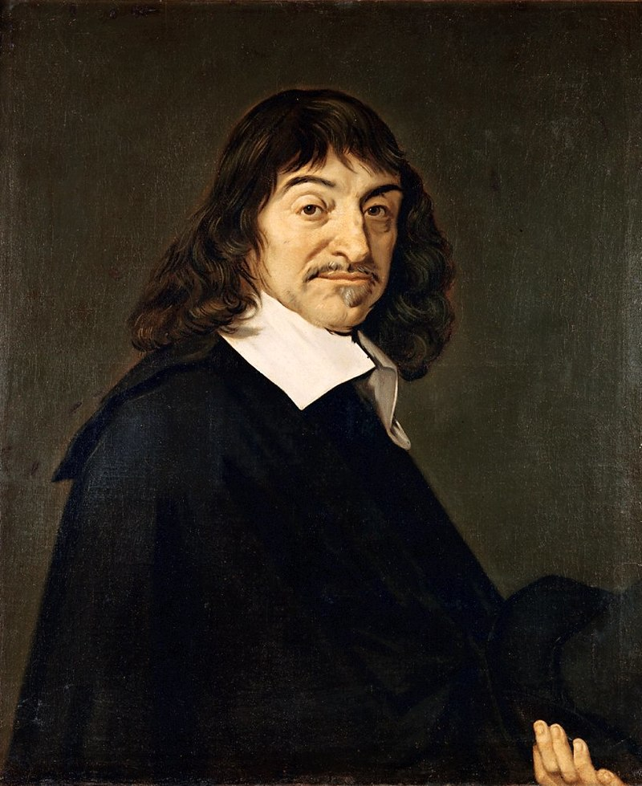
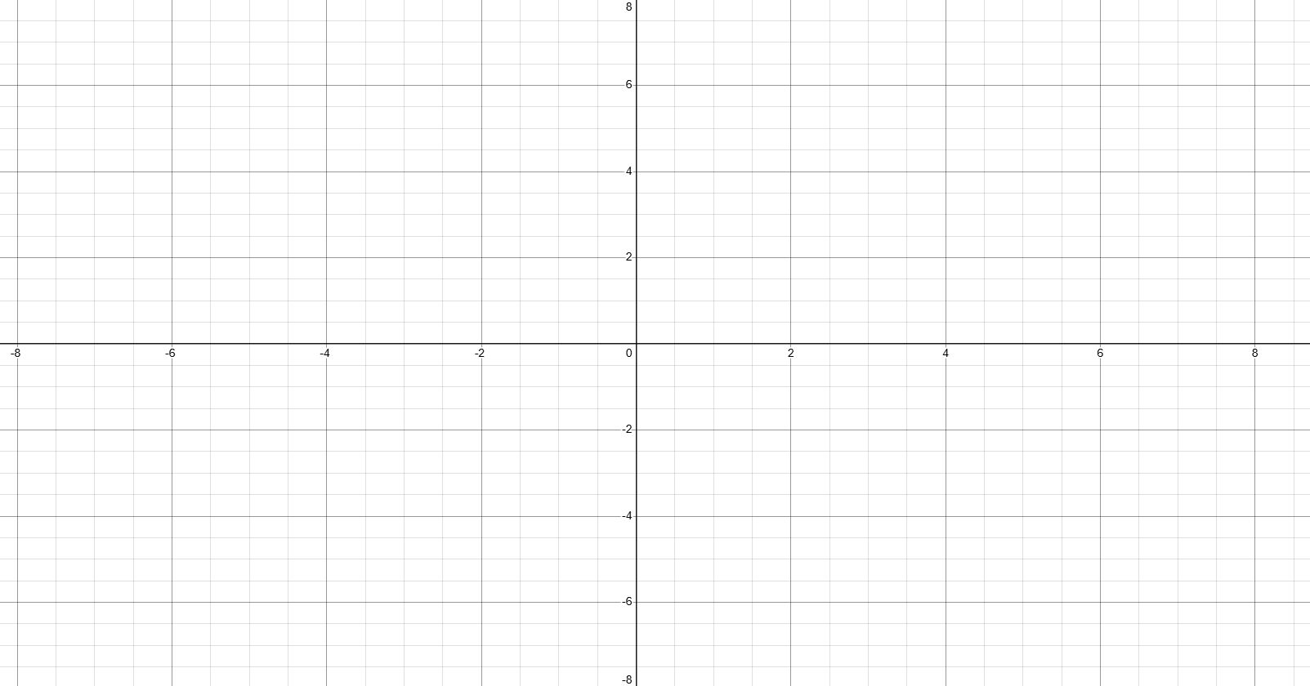




The Cartesian plane
The Cartesian plane is named after French mathematician and philosopher René Descartes (1596–1650). Descartes developed the coordinate system in the 17th century.
The Cartesian plane is divided into
four sections, called quadrants,
by the x-axis and the y-axis.
The diagram here shows a Cartesian
plane with the quadrants labeled.
Notice that Roman numerals are
used to identify the four quadrants.

Slide 2
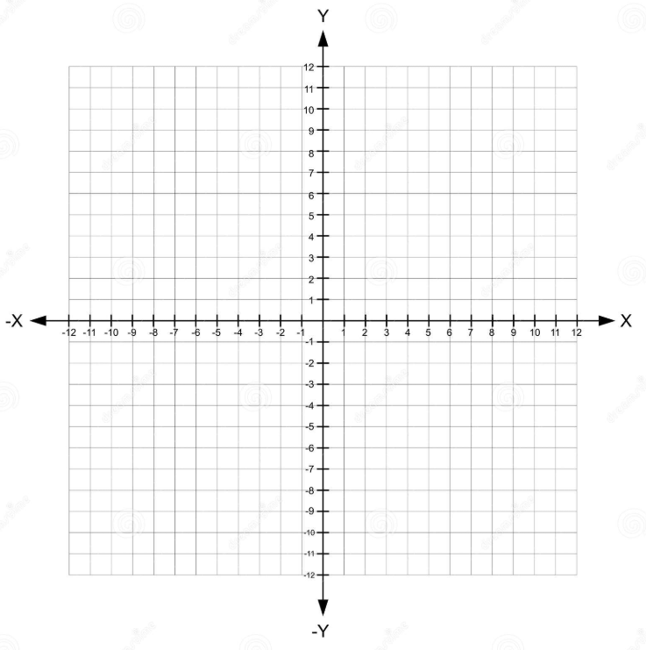

Coordinate
(
$$8$$
,
6
)
Ordered Pair
x value
or x coordinate
y value
or y coordinate
x axis
The origin
y axis
Notes:
Today's video marks the beginning of unit 2 in our course which involves a great deal of graphing. We create a graphs on what's known as the Cartesian plane which is just a fancy phrase or name for a grid pattern using X and Y values. the X values deal with everything horizontal and the Y values deal with everything vertical. for those of you that are historically inclined the Cartesian plane was first introduced by a gentleman by the name of Rene Descartes and has very very many applications in maths Sciences navigation and even the Arts.
The Cartesian plane is made up of two axes the x-axis and the y-axis the x-axis helps us measure or keep track of any horizontal movement and the y-axis keeps track and measures vertical movements. The origin refers to the point in the middle of the graph where the X and Y axes intersect Let's move horizontally to the right eight units and then move up vertically 6 units. At this point no pun intended we'll place a little red dot which will refer to as a coordinate. These two values 8 and 6 help us measure the exact position of this coordinate. The values are always referred to in this order the x value or coordinate first followed by the y-coordinate separated by a comma. they are often enclosed in Brackets and are referred to as an ordered pair.

Slide 3
H
(-6, 7)
7
K
(5, 4)
4
6
1
R
(1, 0)
5
6
3
3
4
5
P
(3, -3)
M
(-6, -4)
(0, -5)
Q

Slide 4
rise
m
=
run
slope
rise
run

Slide 5
slope
rise
run

Slide 6
slope(previous)
rise
slope(new)
run

Slide 7
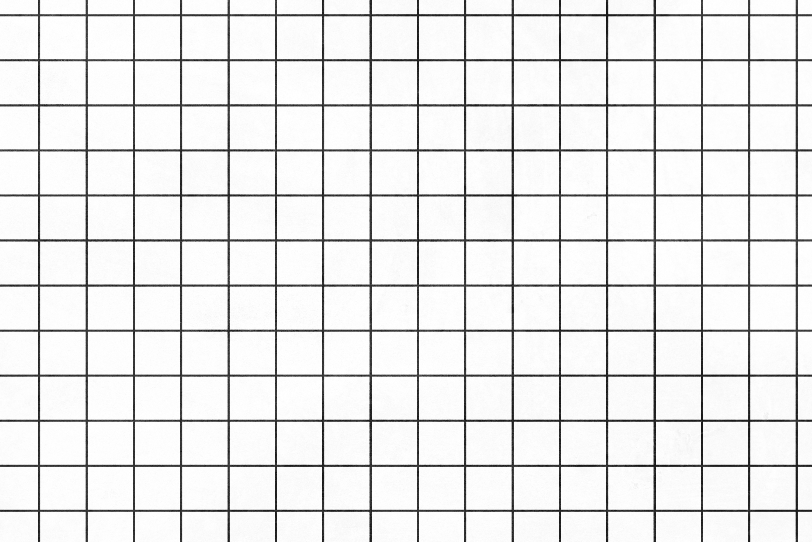

Slide 17
The Effect of Increasing/Decreasing the Rise

Slide 25
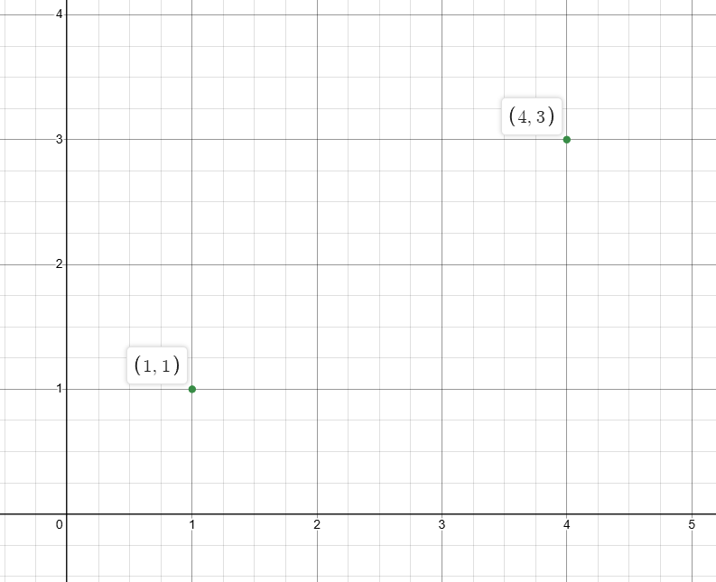
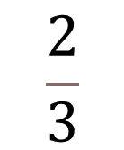
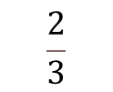
$$\frac{2}{3}$$
rise
m =
run
rise =
2
Consider what a slope of
$$\frac{2}{3}$$
means.
For every 3 units it moves horizontally
across the x axis, it moves 2 units up or
down the y axis.
run =
3

Slide 26
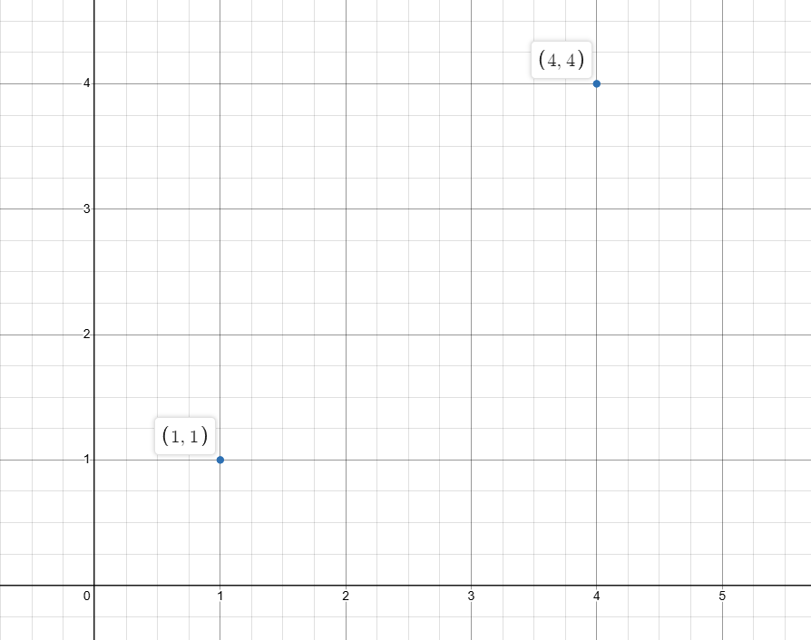
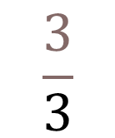

$$\frac{3}{3}$$
m =
=
$$1$$
rise = 3
For every 1 unit the graph moves
horizontally right across the
x axis, it moves 1 unit up the y axis.
run = 3

Slide 27
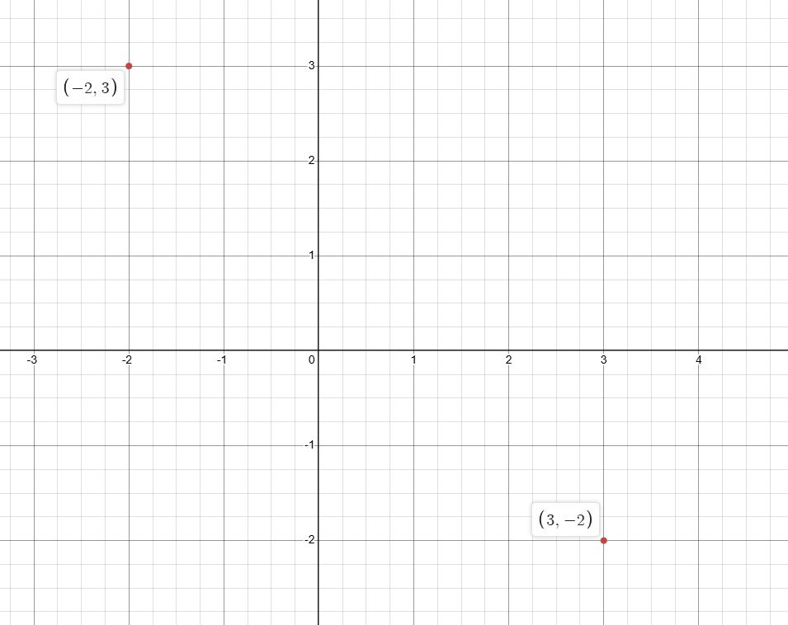
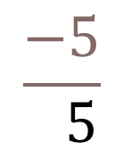

run = 5
$$\frac{−5}{ 5}$$
m =
=
$$−1$$
rise = -5
For every 1 unit the graph moves right across the x axis, it moves 1 unit down
the y axis.

